Slide 1
St. Louis Central Corridor West Building Permits
Monthly Report: July 2021

Slide 2
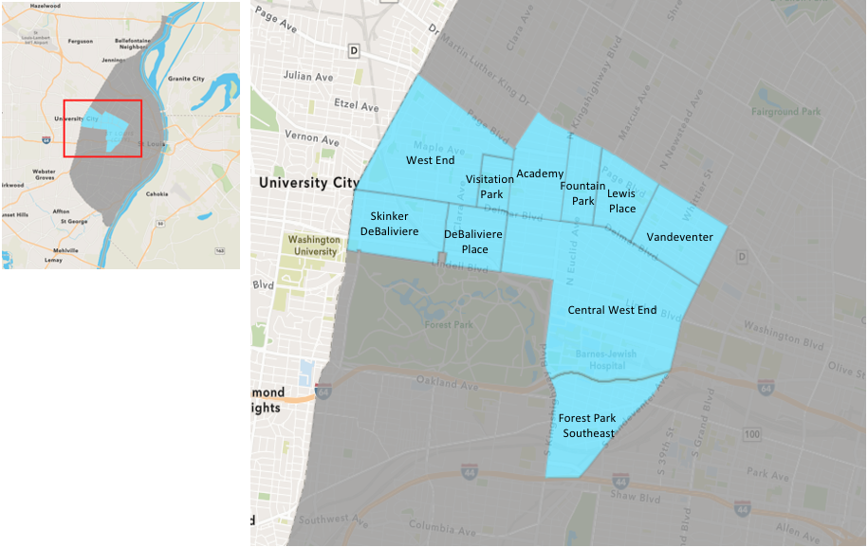
St. Louis Neighborhood Spatial Reference

Slide 3
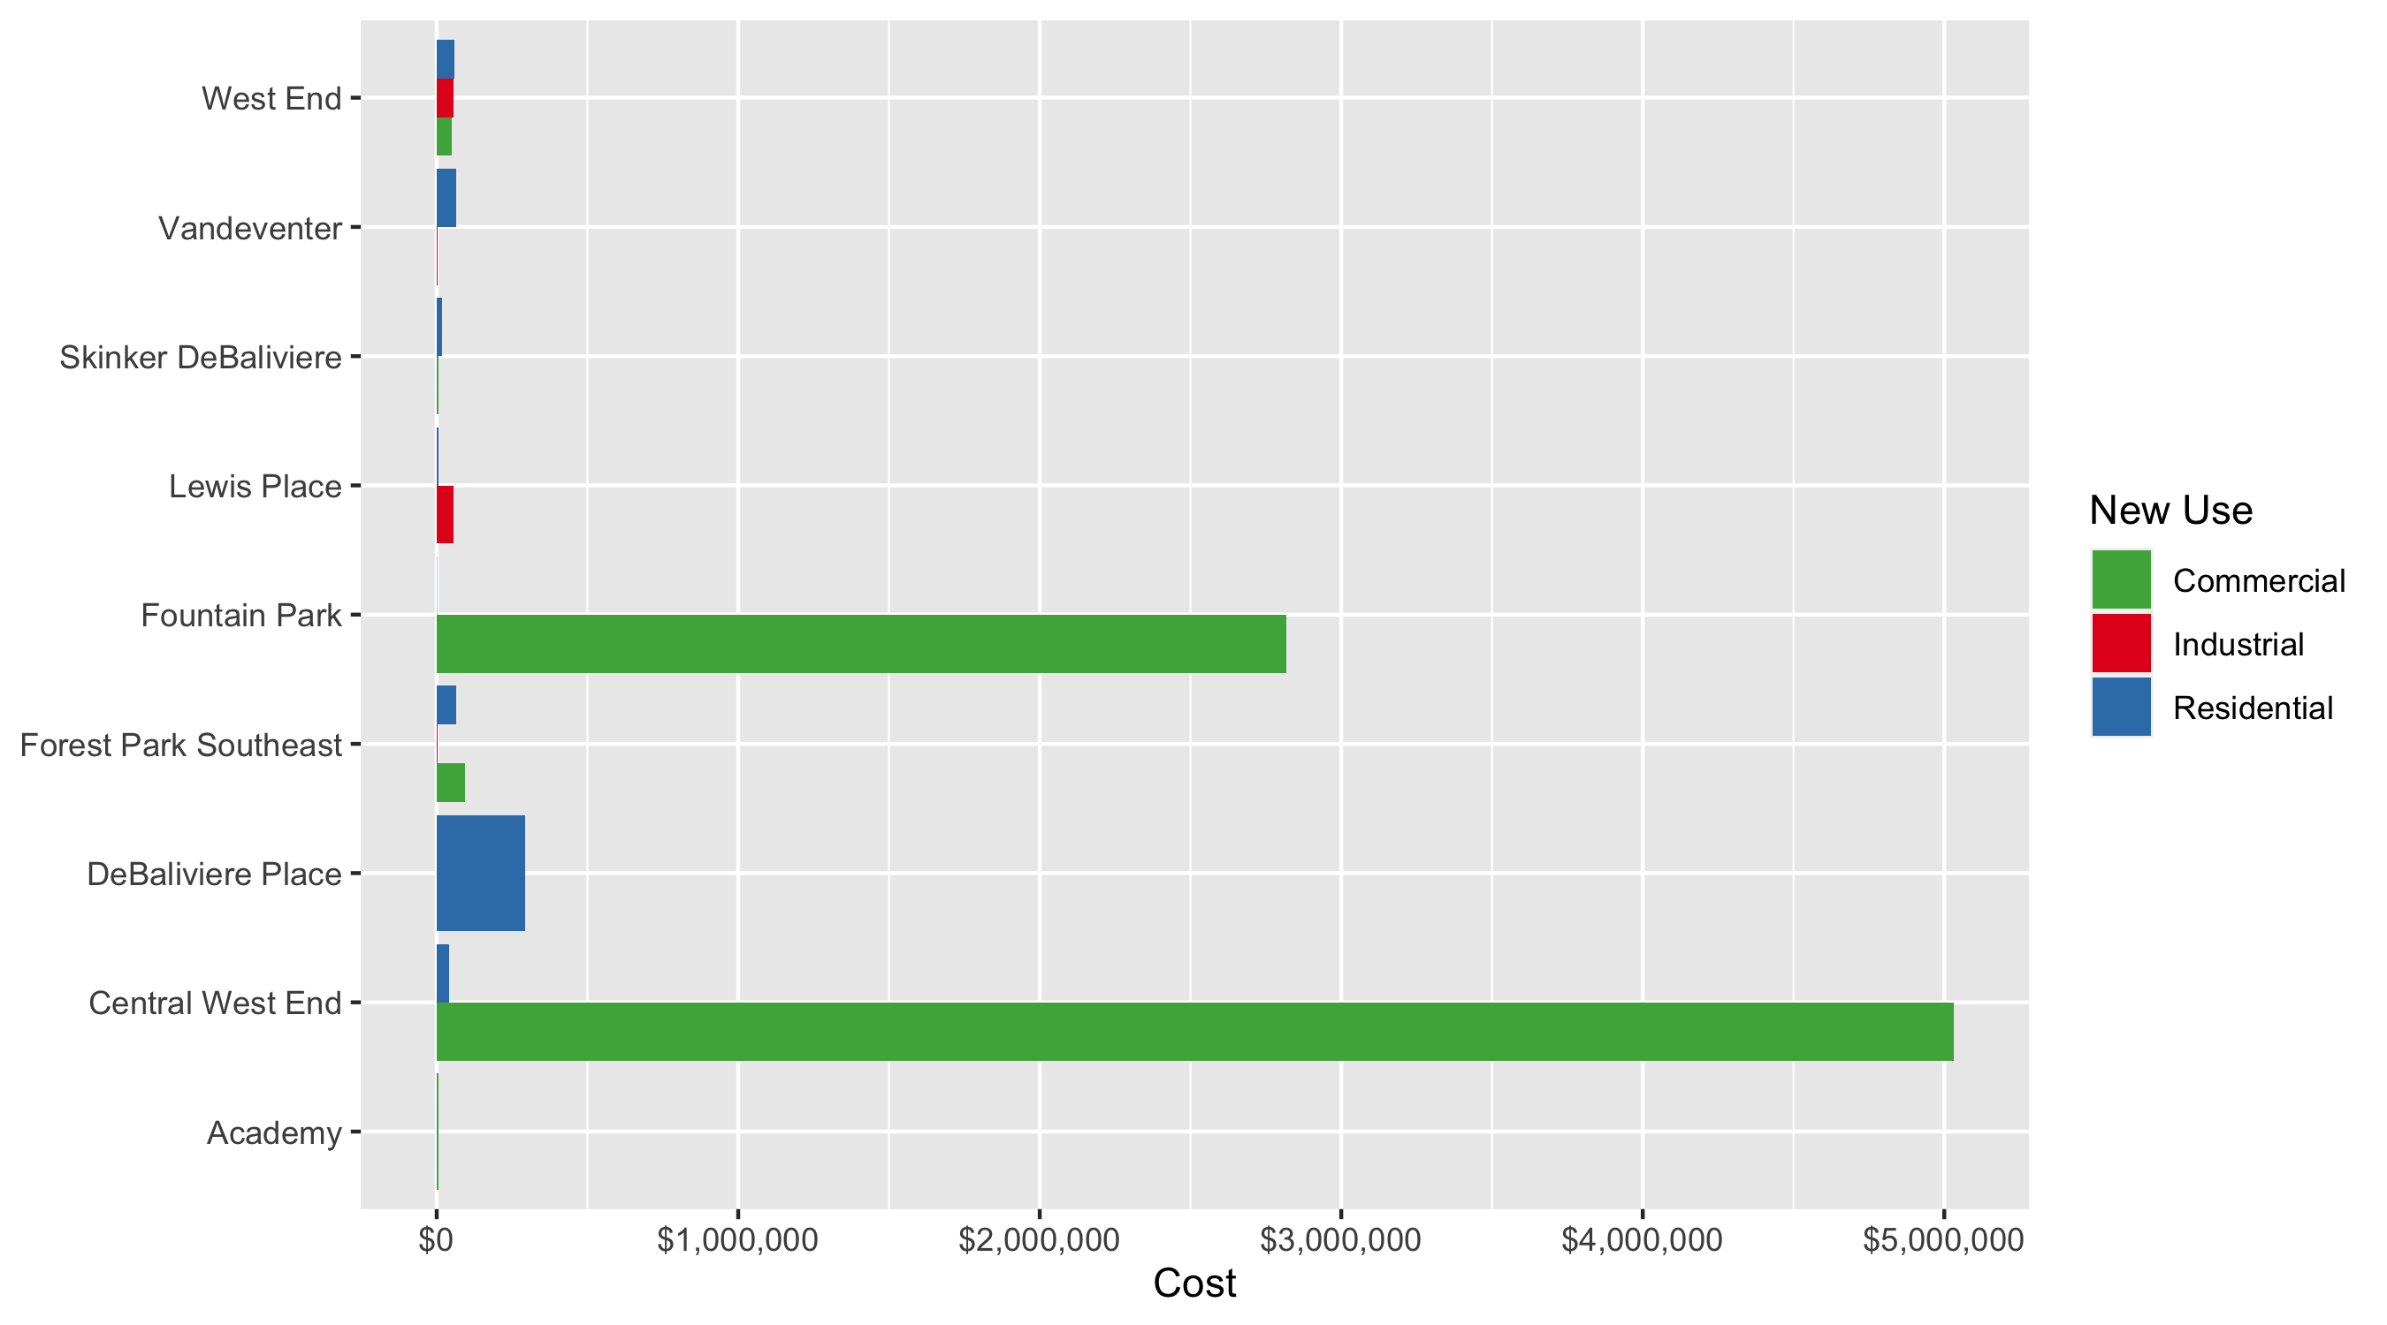
Neighborhood Summary: Average Building Permit Cost

Slide 4
Neighborhood Summary
July 2021 | July 2021 | July 2021 | July 2021
Neighborhood | Average Cost | # of Permits | Total Value of Permits
Academy | $4,500.00 | 1 | $4,500
Central West End | $2,037,285.49 | 35 | $71,304,992
DeBaliviere Place | $293,950.00 | 4 | $1,175,800
Forest Park Southeast | $69,607.17 | 18 | $1,252,929
Fountain Park | $1,408,873.50 | 2 | $2,817,747
Lewis Place | $30,500.00 | 2 | $61,000
Skinker DeBaliviere | $17,207.40 | 10 | $172,074
Vandeventer | $34,150.00 | 2 | $68,300
Visitation Park | $0.00 | 0 | $0
West End | $55,524.20 | 10 | $555,242
Last 6 Months | Last 6 Months | Last 6 Months | Last 6 Months
Neighborhood | Average Cost | # of Permits | Total Value of Permits
Academy | $42,040.07 | 46 | $1,933,843
Central West End | $826,419.18 | 599 | $495,025,088
DeBaliviere Place | $207,559.86 | 76 | $15,774,549
Forest Park Southeast | $412,013.55 | 209 | $86,110,831
Fountain Park | $370,209.11 | 18 | $6,663,764
Lewis Place | $23,702.87 | 23 | $545,166
Skinker DeBaliviere | $418,896.41 | 162 | $67,861,219
Vandeventer | $38,728.89 | 19 | $735,849
Visitation Park | $16,747.00 | 7 | $117,229
West End | $229,658.43 | 141 | $32,381,839

Slide 5
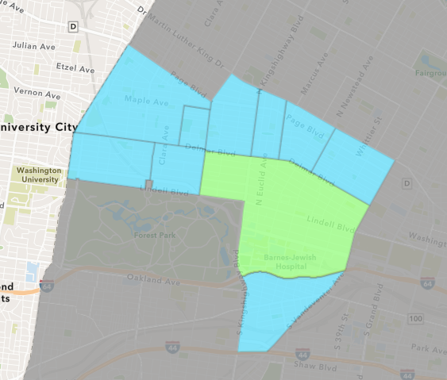
Central West End
July 2021 Neighborhood Cost Breakdown
Mean: $2,037,285
Median: $20,000
Range: $200 - $60,811,820

Slide 6
Central West End: Summary Notes
35 building permits in July 2021
-5.41% change compared to July 2020 (37 total building permits)
$2,037,285: Average building permit cost in July 2021
2380.89% change compared to July 2020 ($82,119)
253 total building permits in 2021
15.00% change YTD compared to this time in 2020 (220 total building permits)
$1,424,094: YTD average building permit cost in 2021
434.90% change YTD compared to this time in 2020 ($266,236)

Slide 7
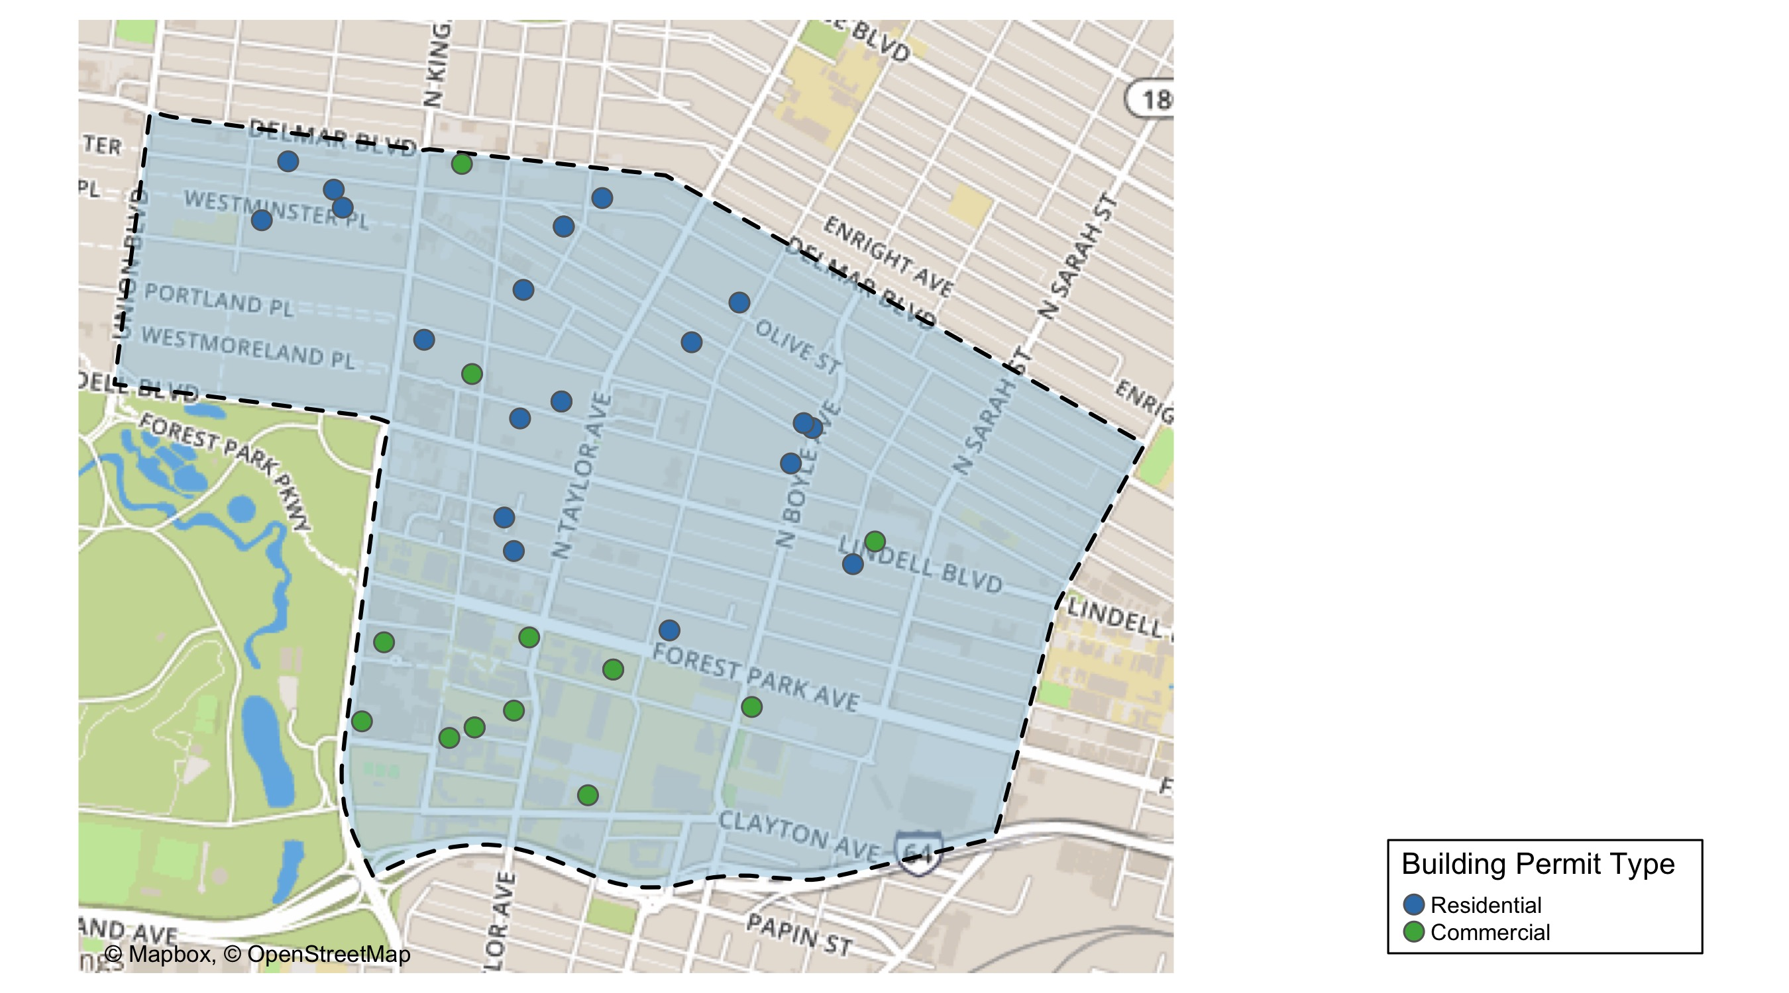
Central West End

Slide 8
Neighborhood Summary
July 2021 | July 2021 | July 2021 | July 2021
Permit Use | Average Cost | # of Permits | Total Value of Permits
Commercial | $5,030,547.86 | 14 | $70,427,670
Industrial | $0.00 | 0 | $0
Residential | $41,777.24 | 21 | $877,322
Last 6 Months | Last 6 Months | Last 6 Months | Last 6 Months
Permit Use | Average Cost | # of Permits | Total Value of Permits
Commercial | $1,496,658.4 | 269 | $402,601,110
Industrial | $1,239,466.0 | 27 | $33,465,583
Residential | $194,582.2 | 303 | $58,958,394

Slide 9
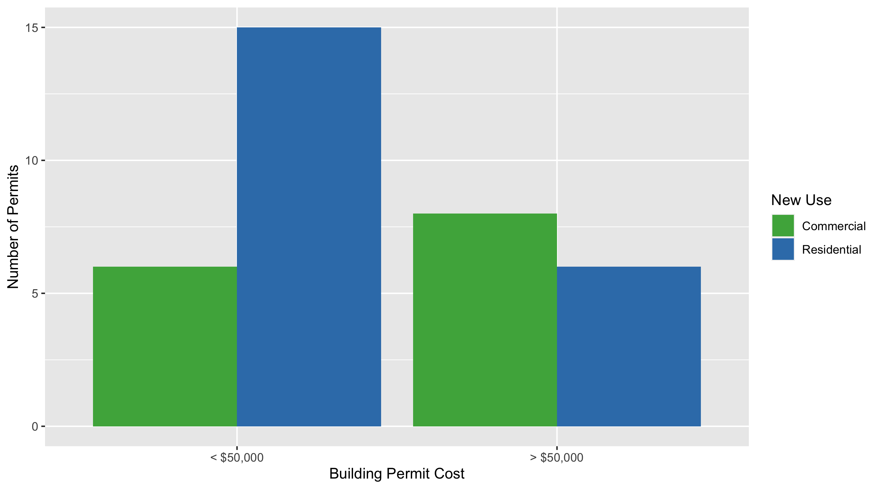
Central West End Permit Cost Breakdown

Slide 10
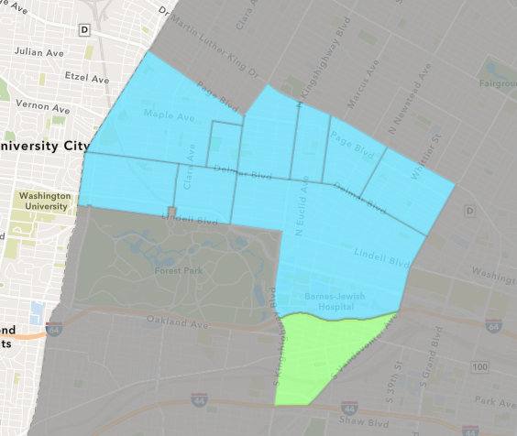
Forest Park Southeast
July 2021 Neighborhood Cost Breakdown
Mean: $69,607
Median: $23,250
Range: $310 - $390,150

Slide 11
Forest Park Southeast: Summary Notes
18 building permits in July 2021
157.14% change compared to July 2020 (7 total building permits)
$69,607: Average building permit cost in July 2021
184.04% change compared to July 2020 ($24,506)
104 total building permits in 2021
57.58% change YTD compared to this time in 2020 (66 total building permits)
$581,471: YTD average building permit cost in 2021
147.87% change YTD compared to this time in 2020 ($234,586)

Slide 12
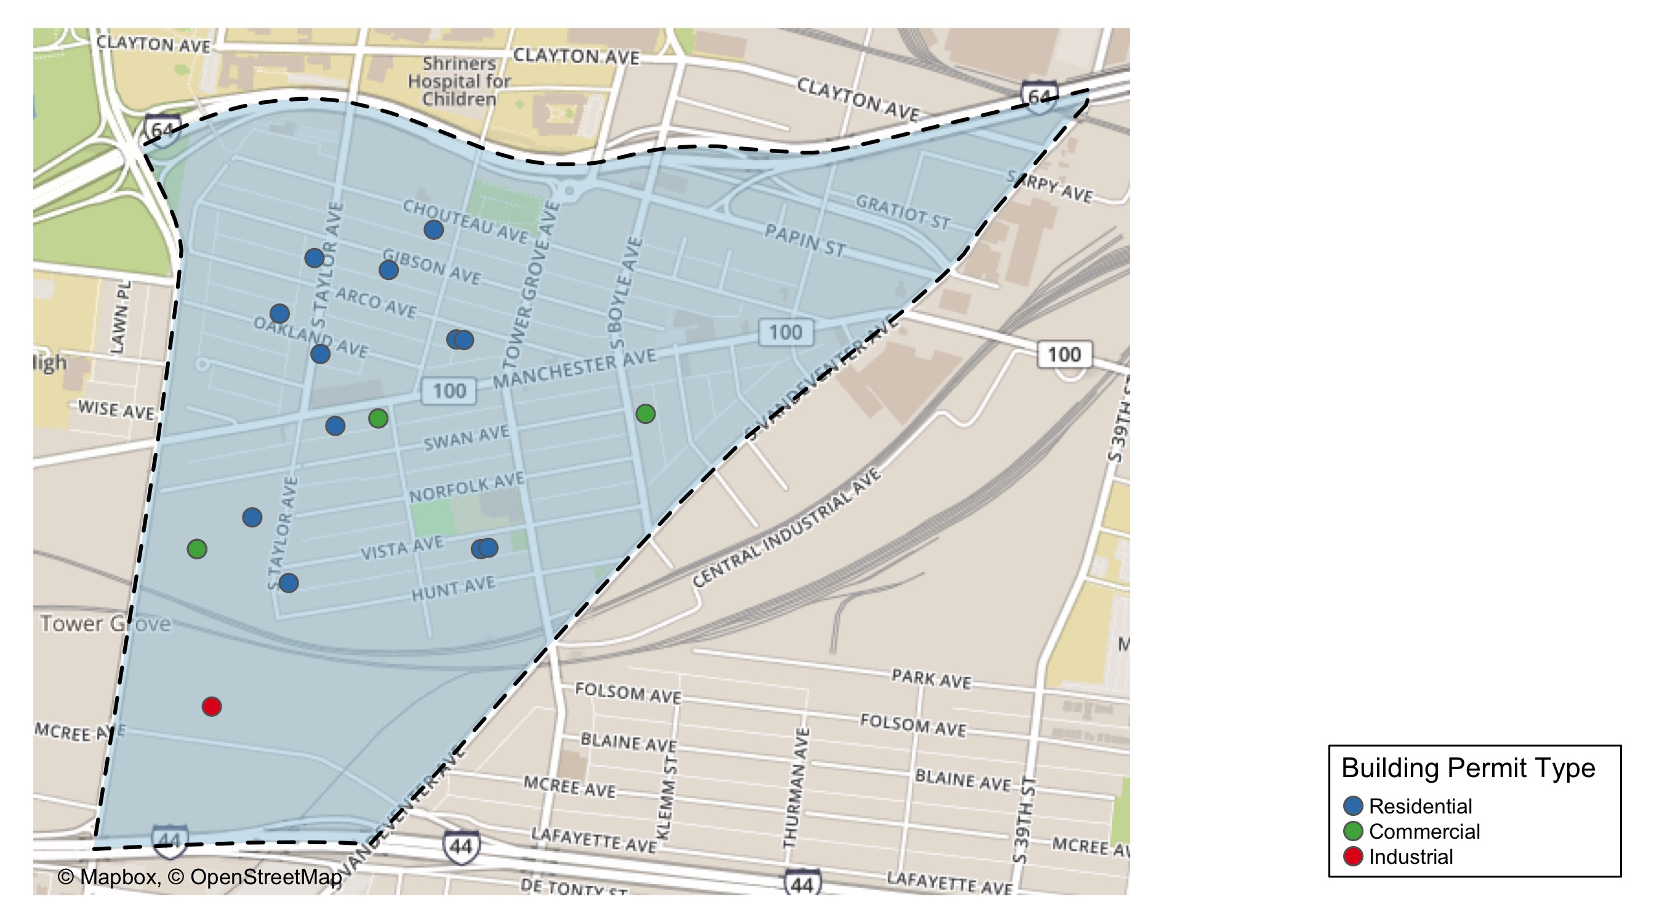
Forest Park Southeast

Slide 13
Neighborhood Summary
July 2021 | July 2021 | July 2021 | July 2021
Permit Use | Average Cost | # of Permits | Total Value of Permits
Commercial | $94,344.80 | 5 | $471,724
Industrial | $1,690.00 | 1 | $1,690
Residential | $64,959.58 | 12 | $779,515
Last 6 Months | Last 6 Months | Last 6 Months | Last 6 Months
Permit Use | Average Cost | # of Permits | Total Value of Permits
Commercial | $443,232.47 | 59 | $26,150,716
Industrial | $66,299.29 | 14 | $928,190
Residential | $434,058.27 | 136 | $59,031,925

Slide 14
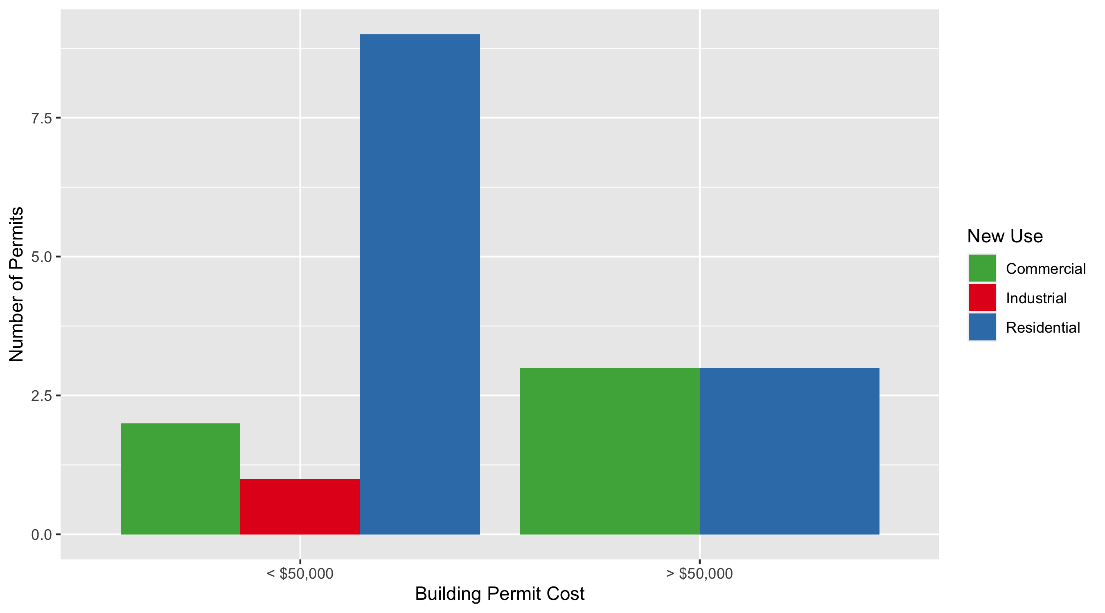
Forest Park Southeast Permit Cost Breakdown

Slide 15
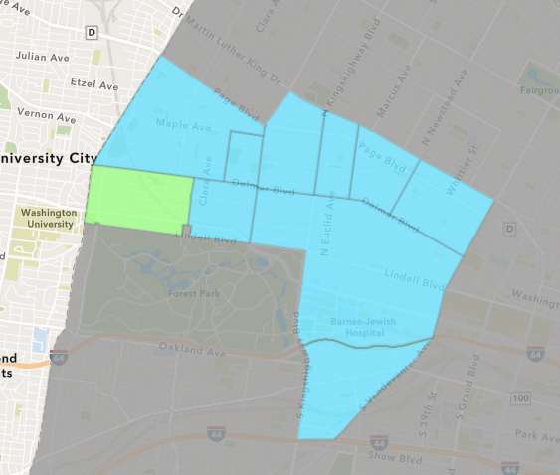
Skinker DeBaliviere
July 2021 Neighborhood Cost Breakdown
Mean: $17,207
Median: $11,220
Range: $4,510 - $75,000

Slide 16
Skinker DeBaliviere: Summary Notes
10 building permits in July 2021
-9.09% change compared to July 2020 (11 total building permits)
$17,207: Average building permit cost in July 2021
-99.68% change compared to July 2020 ($5,459,400)
58 total building permits in 2021
-10.77% change YTD compared to this time in 2020 (65 total building permits)
$28,678: YTD average building permit cost in 2021
-96.96% change YTD compared to this time in 2020 ($942,420)

Slide 17
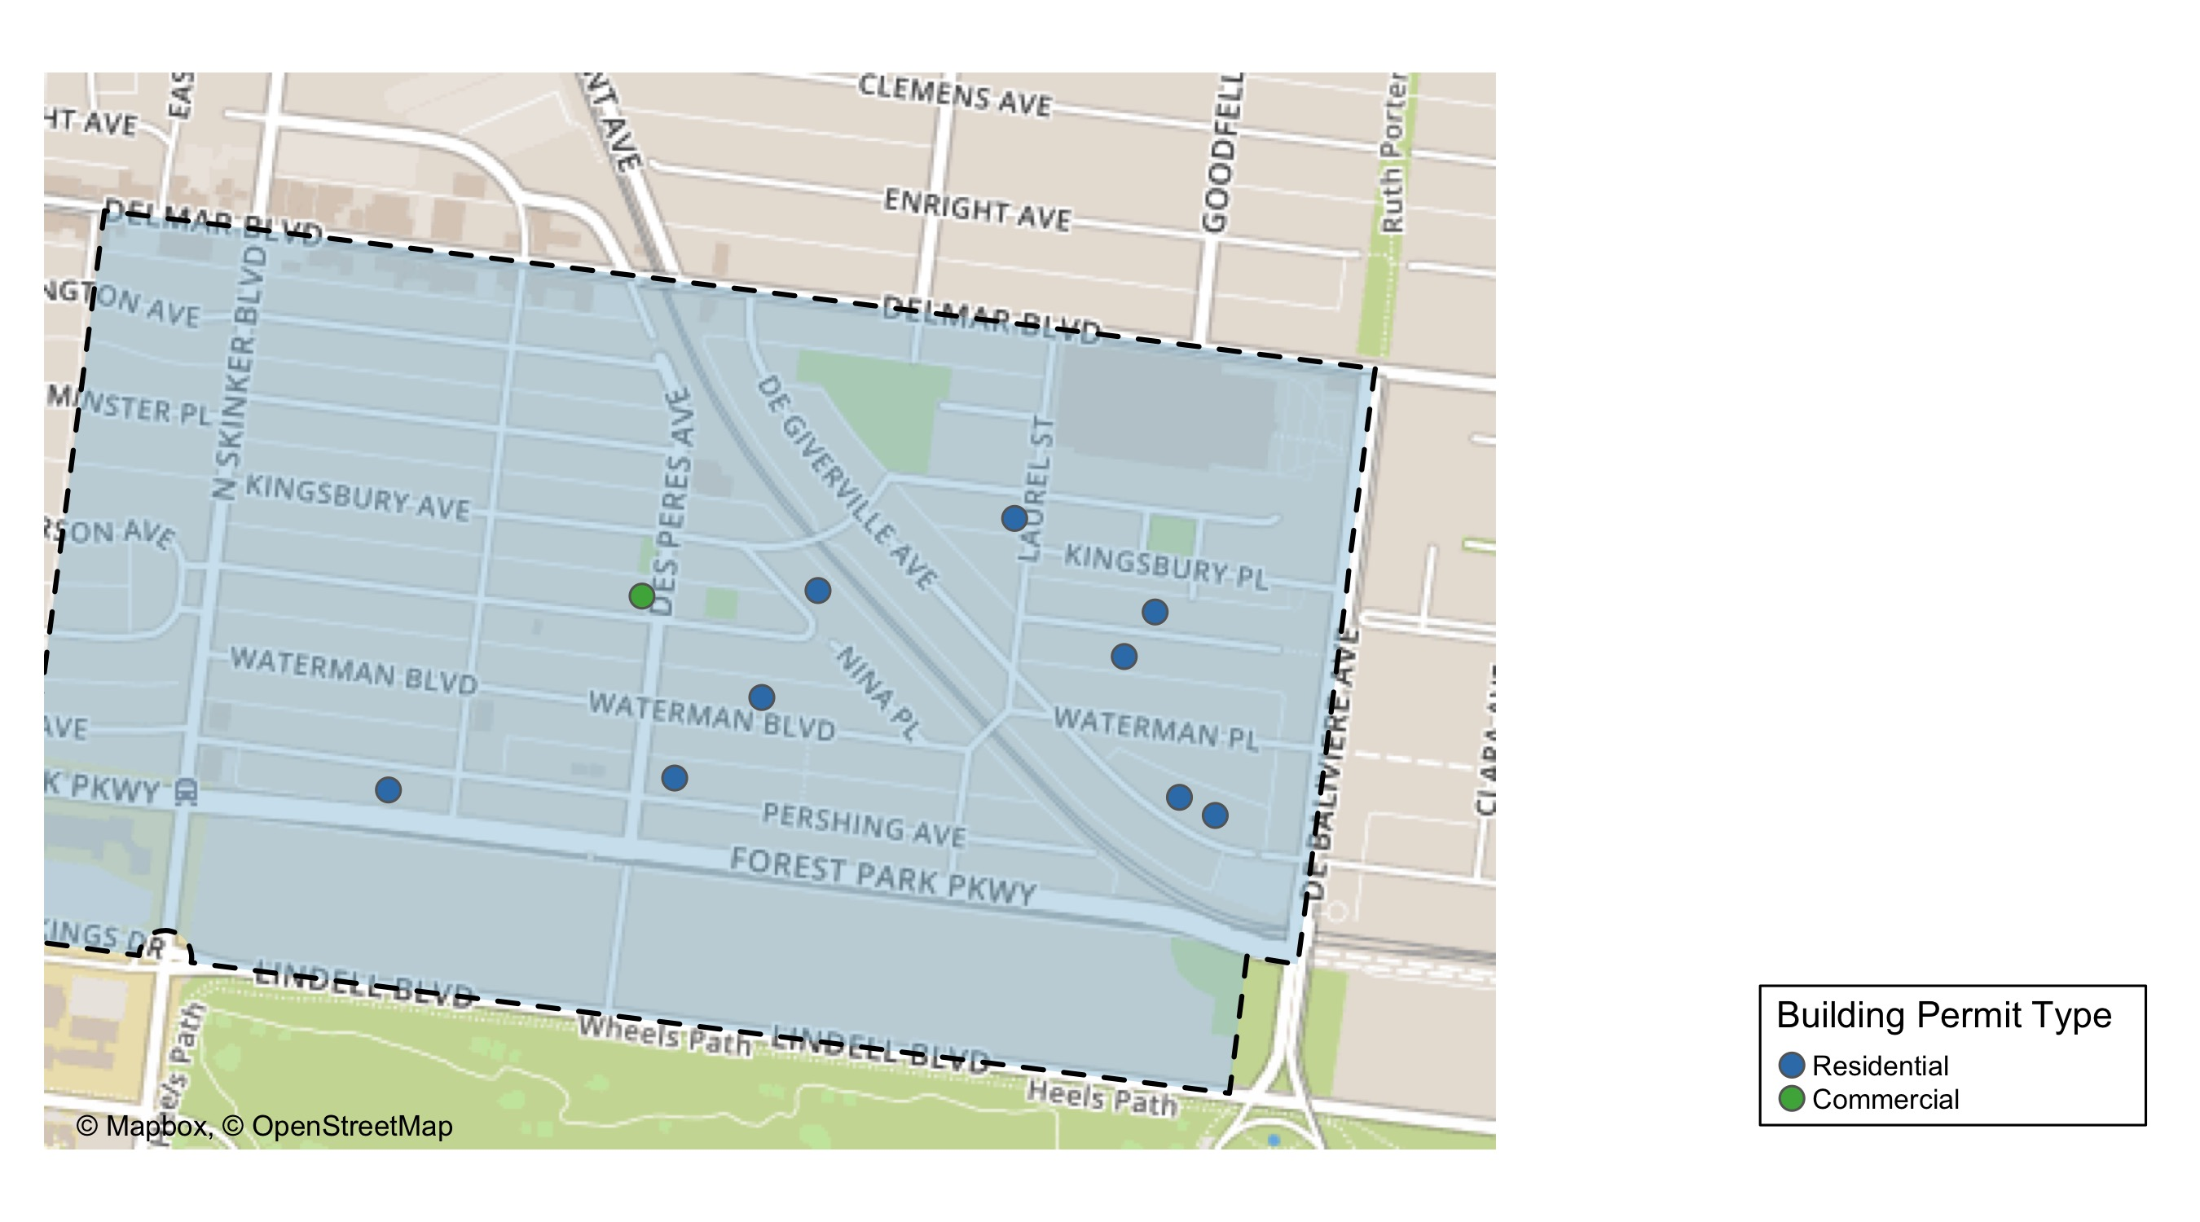
Skinker DeBaliviere

Slide 18
Neighborhood Summary
July 2021 | July 2021 | July 2021 | July 2021
Permit Use | Average Cost | # of Permits | Total Value of Permits
Commercial | $5,000.00 | 1 | $5,000
Industrial | $0.00 | 0 | $0
Residential | $18,563.78 | 9 | $167,074
Last 6 Months | Last 6 Months | Last 6 Months | Last 6 Months
Permit Use | Average Cost | # of Permits | Total Value of Permits
Commercial | $3,548,369.0 | 17 | $60,322,273
Industrial | $14,475.0 | 6 | $86,850
Residential | $53,612.2 | 139 | $7,452,096

Slide 19
Skinker DeBaliviere Individual Permit Breakdown
nbhd_name | Owner | New Use | Cost | address
Skinker DeBaliviere | DENNON, GERALD E | Residential | $26,325 | 5776 MCPHERSON AV
Skinker DeBaliviere | BE A LOCAL LLC SERIES 20 | Residential | $4,800 | 5755 DEGIVERVILLE AV
Skinker DeBaliviere | PORTO DIMORA LLC | Residential | $15,000 | 5771 MCPHERSON AV
Skinker DeBaliviere | WASHINGTON UNIVERSITY | Residential | $75,000 | 6124 PERSHING AV
Skinker DeBaliviere | MORGAN, DEREK PREVO & BILLIE LOUISE | Residential | $12,500 | 5804 WESTMINSTER PL
Skinker DeBaliviere | WASHINGTON UNIVERSITY | Commercial | $5,000 | 6005 MCPHERSON AV
Skinker DeBaliviere | BURBANK, TREVOR TRS | Residential | $10,000 | 5923 WATERMAN BLVD
Skinker DeBaliviere | NAVARRO, HEATHER BROUILLET | Residential | $6,500 | 5953 PERSHING AV
Skinker DeBaliviere | GUERTLER, CHARLOTTE A & ALARIC | Residential | $4,510 | 5735 DEGIVERVILLE AV
Skinker DeBaliviere | DEBALIVIERE PL WEST CONDO PHASE 2 | Residential | $12,439 | 5885 NINA PL

Slide 20
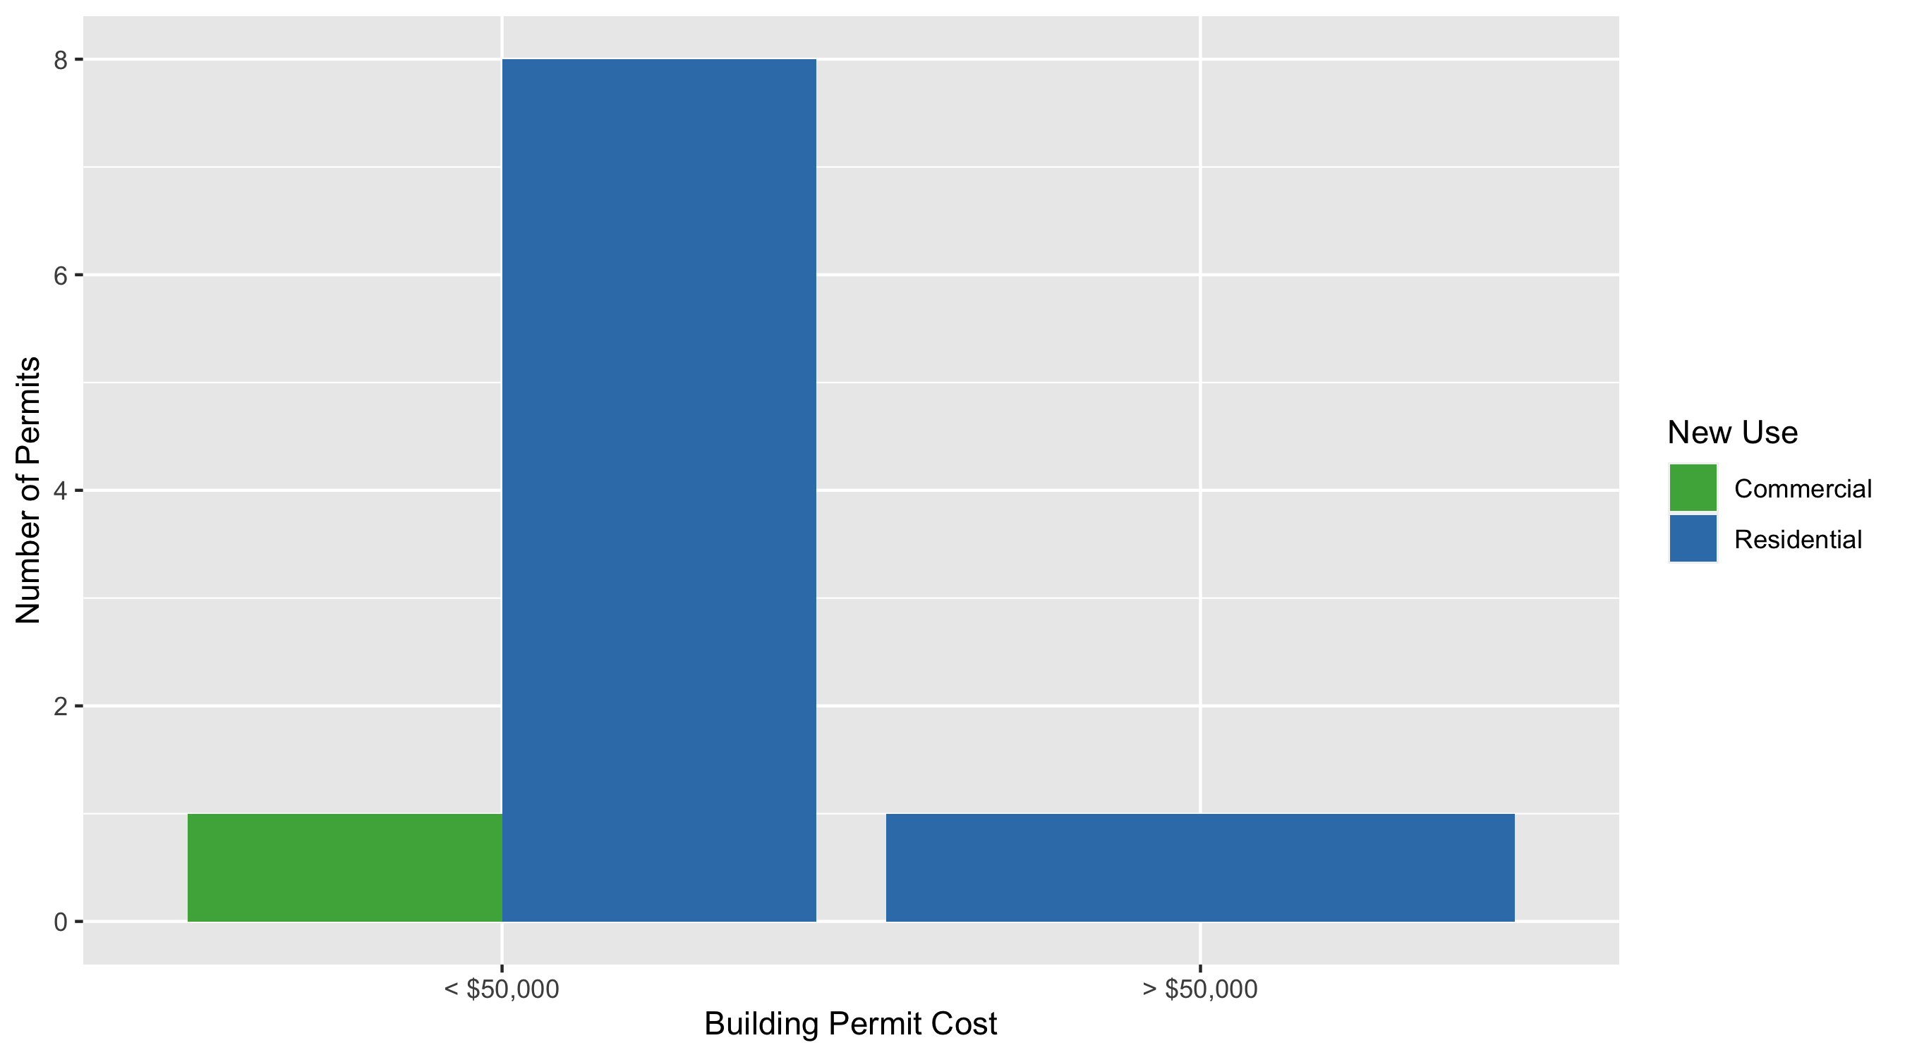
Skinker DeBaliviere Permit Cost Breakdown

Slide 21
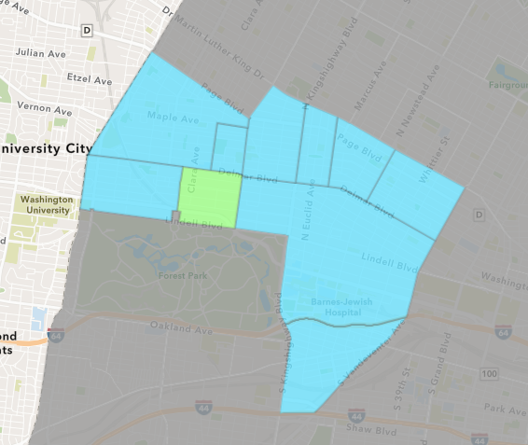
DeBaliviere Place
July 2021 Neighborhood Cost Breakdown
Mean: $293,950
Median: $87,500
Range: $800 - $1,000,000

Slide 22
DeBaliviere Place: Summary Notes
4 building permits in July 2021
0.00% change compared to July 2020 (4 total building permits)
$293,950: Average building permit cost in July 2021
2946.11% change compared to July 2020 ($9,650)
34 total building permits in 2021
88.89% change YTD compared to this time in 2020 (18 total building permits)
$98,115: YTD average building permit cost in 2021
-48.98% change YTD compared to this time in 2020 ($192,321)

Slide 23
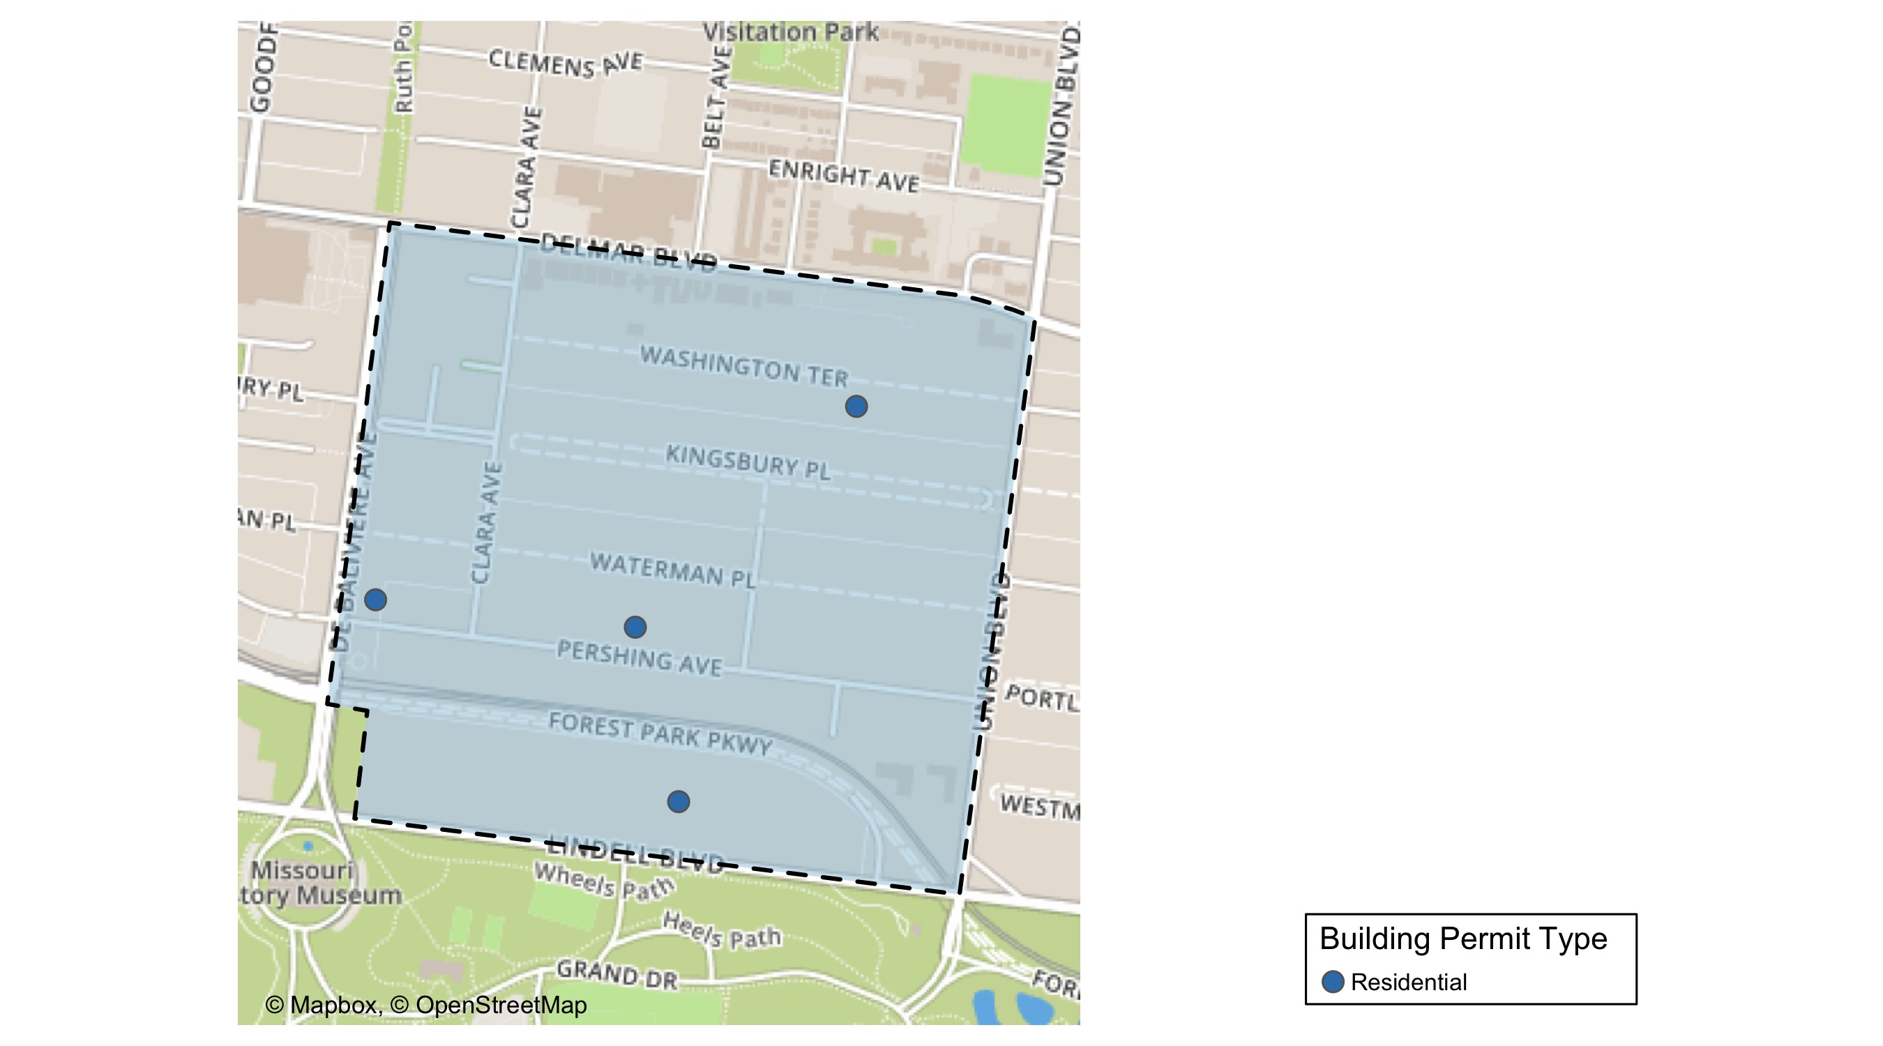
DeBaliviere Place

Slide 24
Neighborhood Summary
July 2021 | July 2021 | July 2021 | July 2021
Permit Use | Average Cost | # of Permits | Total Value of Permits
Commercial | $0 | 0 | $0
Industrial | $0 | 0 | $0
Residential | $293,950 | 4 | $1,175,800
Last 6 Months | Last 6 Months | Last 6 Months | Last 6 Months
Permit Use | Average Cost | # of Permits | Total Value of Permits
Commercial | $33,466.0 | 6 | $200,796
Industrial | $34,500.0 | 3 | $103,500
Residential | $230,899.3 | 67 | $15,470,253

Slide 25
DeBaliviere Place Individual Permit Breakdown
nbhd_name | Owner | New Use | Cost | address
DeBaliviere Place | KNESE, LEONARD H & SUSANNE J | Residential | $1,000,000 | 5505 LINDELL BLVD
DeBaliviere Place | HUDSON KILAMANJARO V LLC | Residential | $35,000 | 5655 PERSHING AV
DeBaliviere Place | RAINIER ONE LLC | Residential | $800 | 5539 PERSHING AV
DeBaliviere Place | FEHLIG, EDWARD K & SARAH G | Residential | $140,000 | 16 WASHINGTON TER

Slide 26
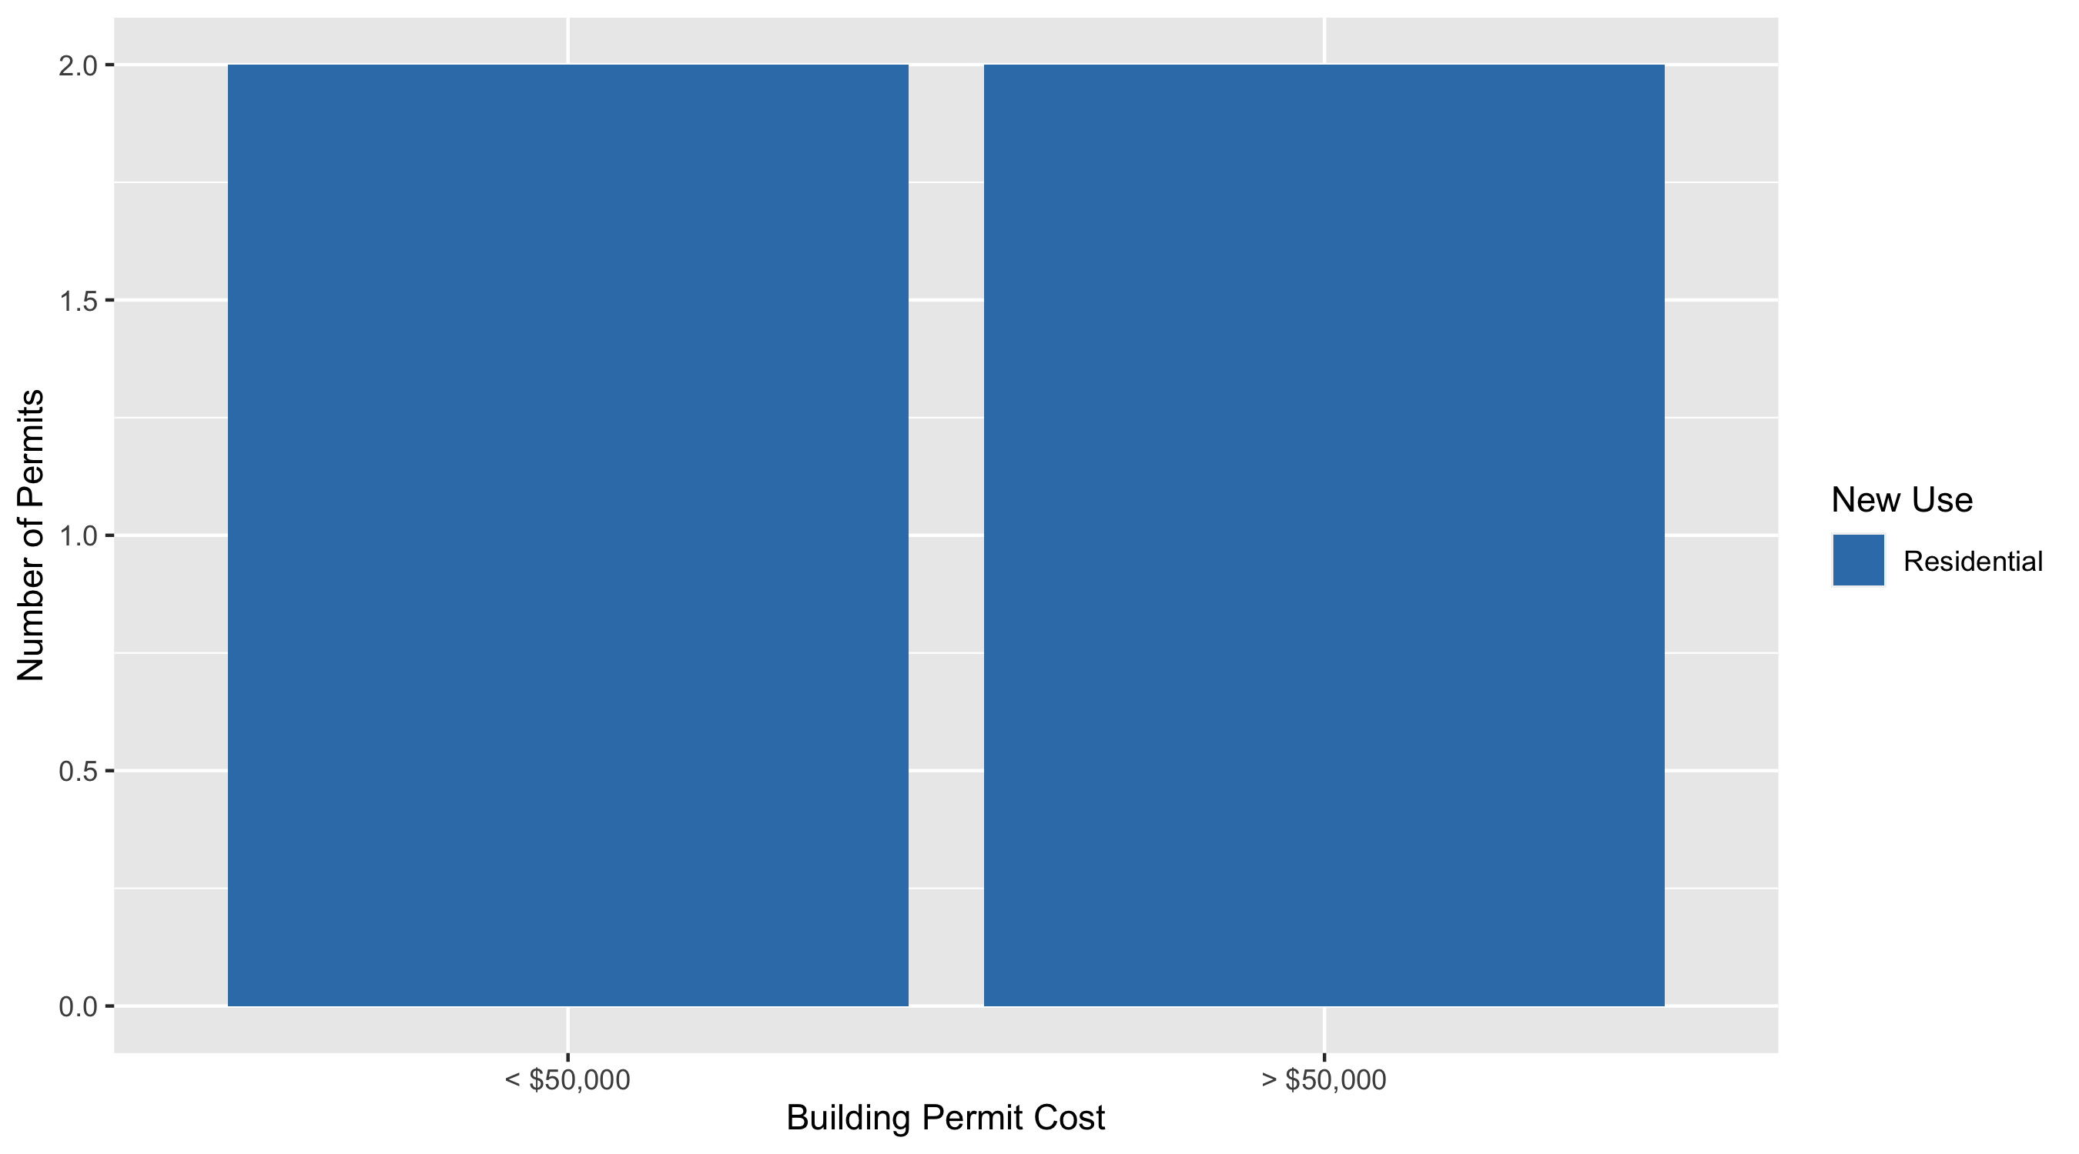
DeBaliviere Place Permit Cost Breakdown

Slide 27
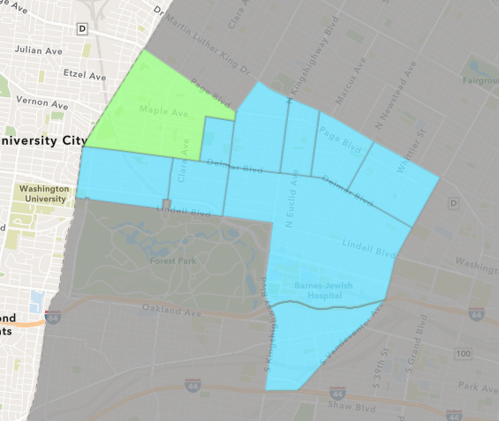
West End
July 2021 Neighborhood Cost Breakdown
Mean: $55,524
Median: $12,500
Range: $1,000 - $267,742

Slide 28
West End: Summary Notes
10 building permits in July 2021
150.00% change compared to July 2020 (4 total building permits)
$55,524: Average building permit cost in July 2021
-32.47% change compared to July 2020 ($82,225)
78 total building permits in 2021
65.96% change YTD compared to this time in 2020 (47 total building permits)
$99,110: YTD average building permit cost in 2021
-73.66% change YTD compared to this time in 2020 ($376,215)

Slide 29
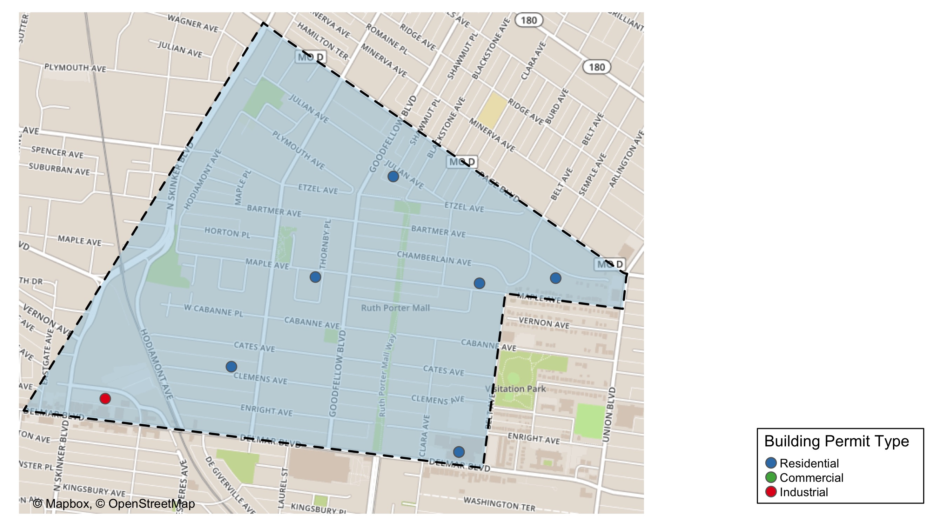
West End

Slide 30
Neighborhood Summary
July 2021 | July 2021 | July 2021 | July 2021
Permit Use | Average Cost | # of Permits | Total Value of Permits
Commercial | $51,333.33 | 3 | $154,000
Industrial | $56,000.00 | 1 | $56,000
Residential | $57,540.33 | 6 | $345,242
Last 6 Months | Last 6 Months | Last 6 Months | Last 6 Months
Permit Use | Average Cost | # of Permits | Total Value of Permits
Commercial | $443,183.6 | 31 | $13,738,691
Industrial | $16,063.5 | 12 | $192,762
Residential | $188,269.2 | 98 | $18,450,386

Slide 31
West End Individual Permit Breakdown
nbhd_name | Owner | New Use | Cost | address
West End | MITCHELL, SHEILA D | Residential | $13,000 | 5728 JULIAN AV
West End | PAGEANT BUILDING LLC | Industrial | $56,000 | 6100 ENRIGHT AV
West End | DELMAR DIVINE MASTER LANDLORD LLC | Commercial | $8,000 | 5535 DELMAR BLVD
West End | DELMAR DIVINE MASTER LANDLORD LLC | Commercial | $12,000 | 5535 DELMAR BLVD
West End | DELMAR DIVINE CONDO | Residential | $267,742 | 5535 DELMAR BLVD
West End | DELMAR DIVINE CONDO | Commercial | $134,000 | 5535 DELMAR BLVD
West End | WILSON, TATIA K | Residential | $52,000 | 5844 MAPLE AV
West End | BARTMER ONE LLP | Residential | $1,000 | 5424 BARTMER AV
West End | SECURE REALTY INVESTMENTS LLC | Residential | $7,000 | 5535 MAPLE AV
West End | RICHARDSON, LATICIA | Residential | $4,500 | 5939 CLEMENS AV

Slide 32
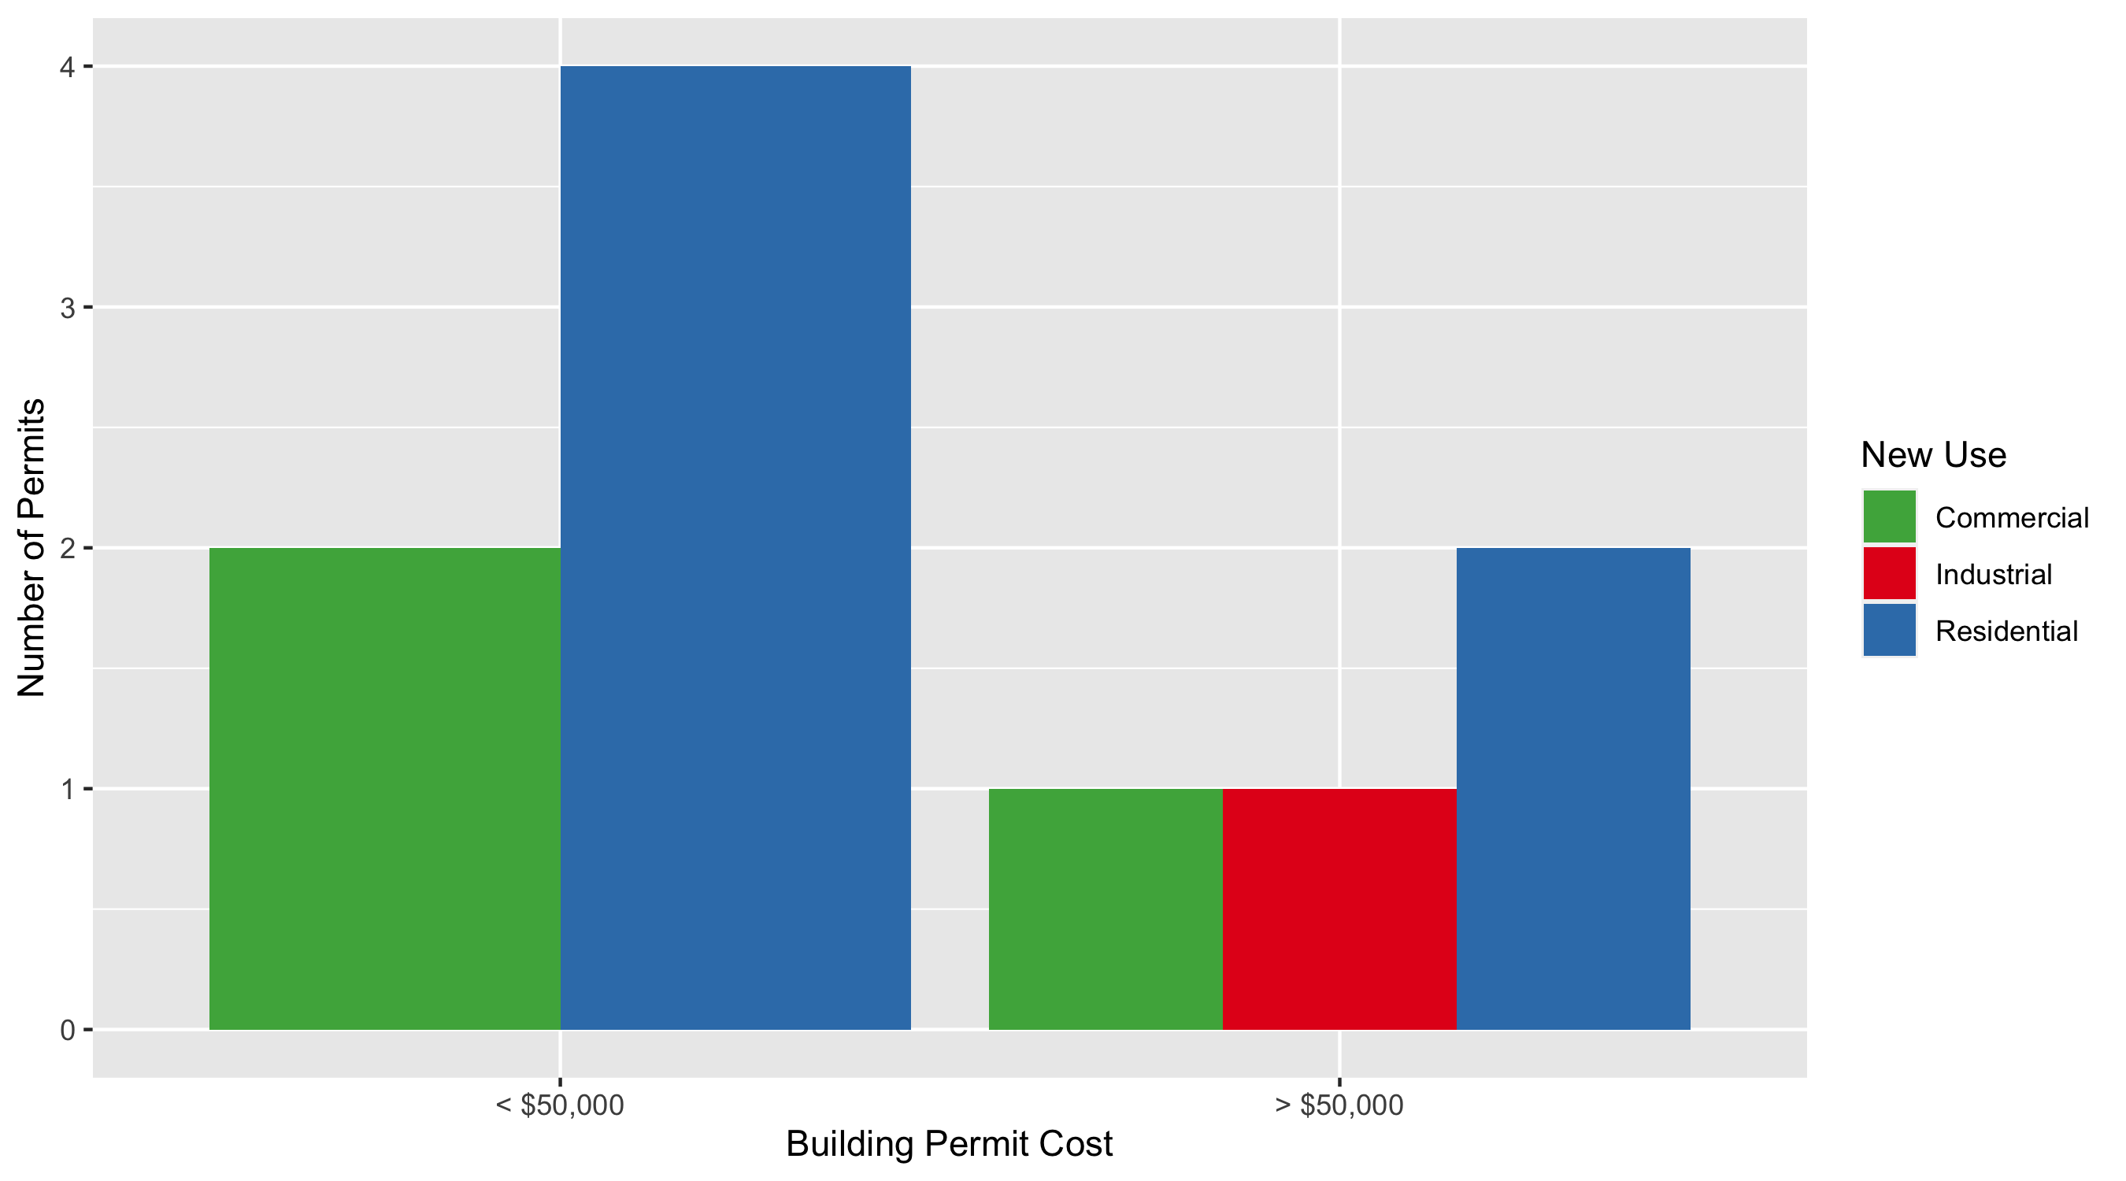
West End Permit Cost Breakdown

Slide 33
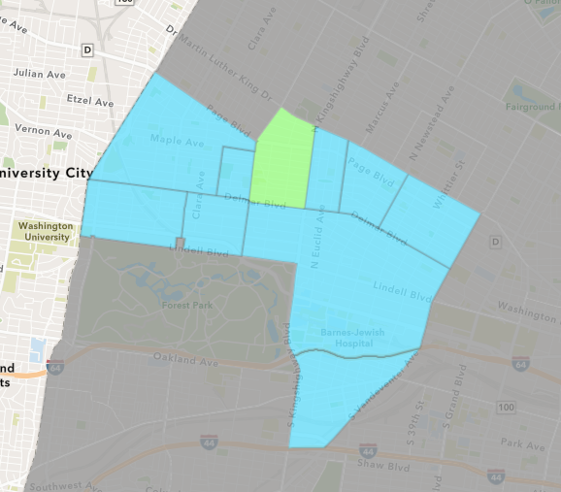
Academy
July 2021 Neighborhood Cost Breakdown
Mean: $4,500
Median: $4,500
Range: $4,500 - $4,500

Slide 34
Academy: Summary Notes
1 building permits in July 2021
-75.00% change compared to July 2020 (4 total building permits)
$4,500: Average building permit cost in July 2021
-80.83% change compared to July 2020 ($23,475)
15 total building permits in 2021
-21.05% change YTD compared to this time in 2020 (19 total building permits)
$49,724: YTD average building permit cost in 2021
-18.05% change YTD compared to this time in 2020 ($60,674)

Slide 35
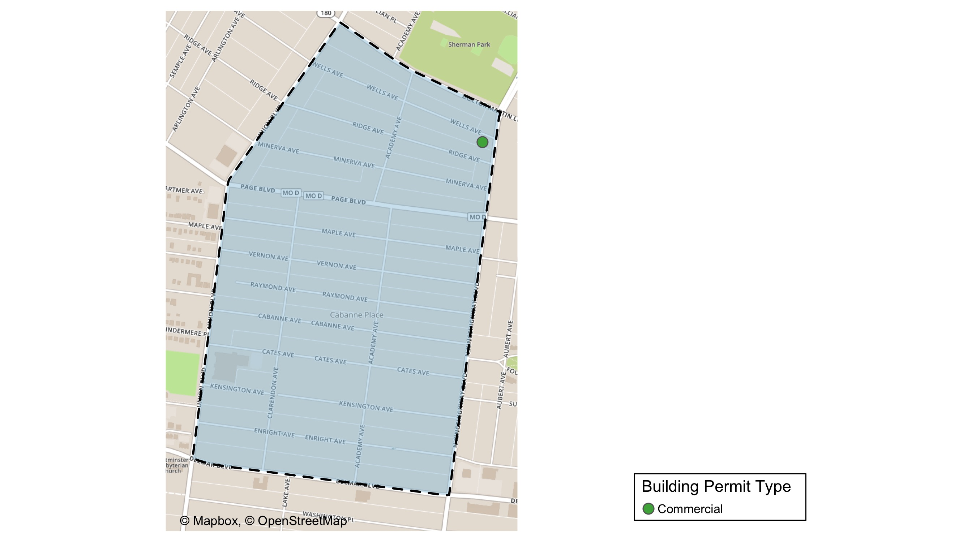
Academy

Slide 36
Neighborhood Summary
July 2021 | July 2021 | July 2021 | July 2021
Permit Use | Average Cost | # of Permits | Total Value of Permits
Commercial | $4,500 | 1 | $4,500
Industrial | $0 | 0 | $0
Residential | $0 | 0 | $0
Last 6 Months | Last 6 Months | Last 6 Months | Last 6 Months
Permit Use | Average Cost | # of Permits | Total Value of Permits
Commercial | $31,250.00 | 4 | $125,000
Industrial | $2,862.50 | 4 | $11,450
Residential | $47,299.82 | 38 | $1,797,393

Slide 37
Academy Individual Permit Breakdown
nbhd_name | Owner | New Use | Cost | address
Academy | THE SHERWIN-WILLIAMS CO | Commercial | $4,500 | 1415 N KINGSHIGHWAY BLVD

Slide 38
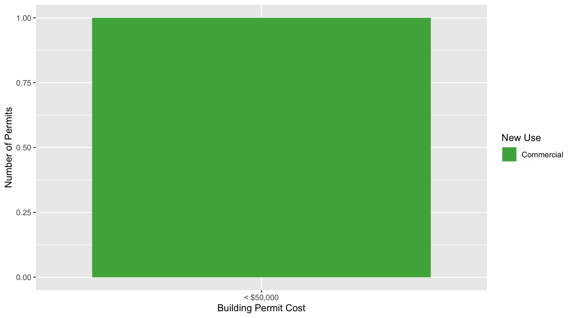
Academy Permit Cost Breakdown

Slide 39
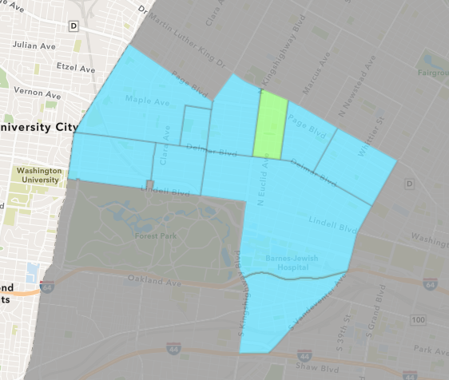
Fountain Park
July 2021 Neighborhood Cost Breakdown
Mean: $1,408,874
Median: $1,408,874
Range: $1,000 - $2,816,747

Slide 40
Fountain Park: Summary Notes
2 building permits in July 2021
Infinite change compared to July 2020 (0 total building permits)
$1,408,874: Average building permit cost in July 2021
Infinite change compared to July 2020 ($0)
12 total building permits in 2021
300.00% change YTD compared to this time in 2020 (3 total building permits)
$536,272: YTD average building permit cost in 2021
11817.16% change YTD compared to this time in 2020 ($4,500)

Slide 41
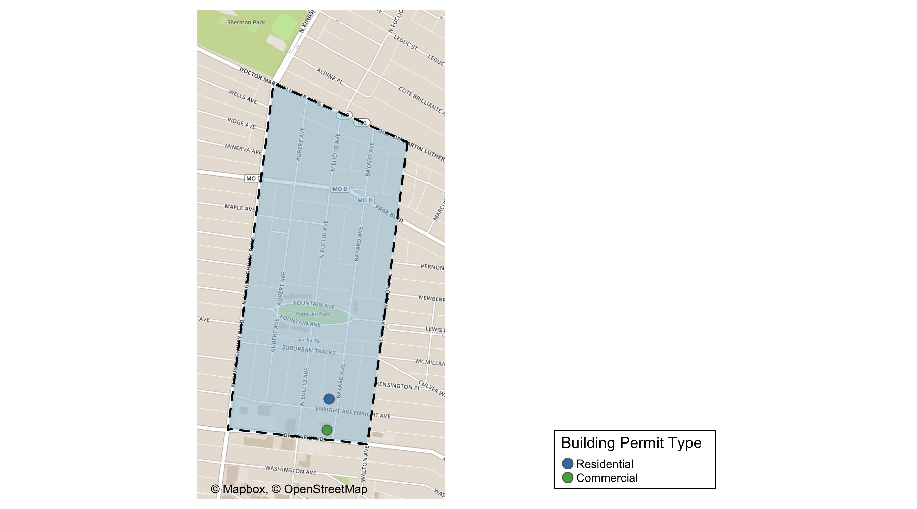
Fountain Park

Slide 42
Neighborhood Summary
July 2021 | July 2021 | July 2021 | July 2021
Permit Use | Average Cost | # of Permits | Total Value of Permits
Commercial | $2,816,747 | 1 | $2,816,747
Industrial | $0 | 0 | $0
Residential | $1,000 | 1 | $1,000
Last 6 Months | Last 6 Months | Last 6 Months | Last 6 Months
Permit Use | Average Cost | # of Permits | Total Value of Permits
Commercial | $1,279,953 | 5 | $6,399,764
Industrial | $27,500 | 2 | $55,000
Residential | $19,000 | 11 | $209,000

Slide 43
Fountain Park Individual Permit Breakdown
nbhd_name | Owner | New Use | Cost | address
Fountain Park | LAUNCHCODE 4811 DELMAR BUILDING OWNE | Commercial | $2,816,747 | 4811 DELMAR BLVD
Fountain Park | PATE, DOROTHY A | Residential | $1,000 | 749 BAYARD AV

Slide 44
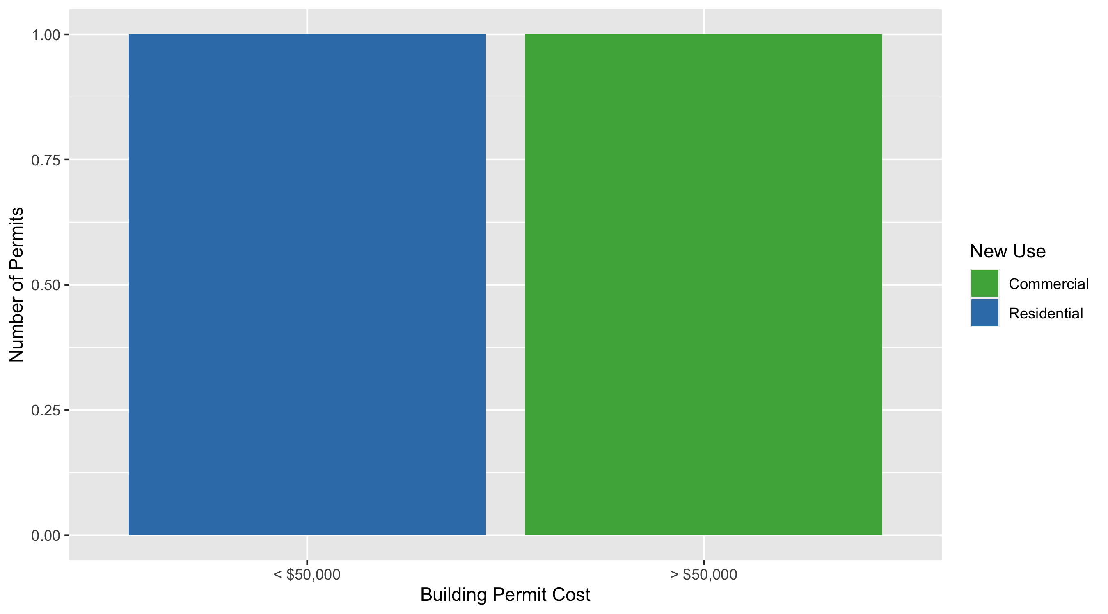
Fountain Park Permit Cost Breakdown

Slide 45
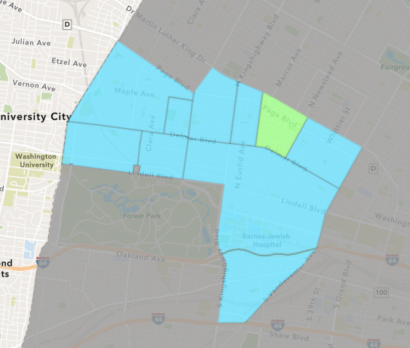
Lewis Place
July 2021 Neighborhood Cost Breakdown
Mean: $30,500
Median: $30,500
Range: $5,000 - $56,000

Slide 46
Lewis Place: Summary Notes
2 building permits in July 2021
Infinite change compared to July 2020 (0 total building permits)
$30,500: Average building permit cost in July 2021
Infinite change compared to July 2020 ($0)
10 total building permits in 2021
233.33% change YTD compared to this time in 2020 (3 total building permits)
$16,507: YTD average building permit cost in 2021
6974.26% change YTD compared to this time in 2020 ($233)

Slide 47
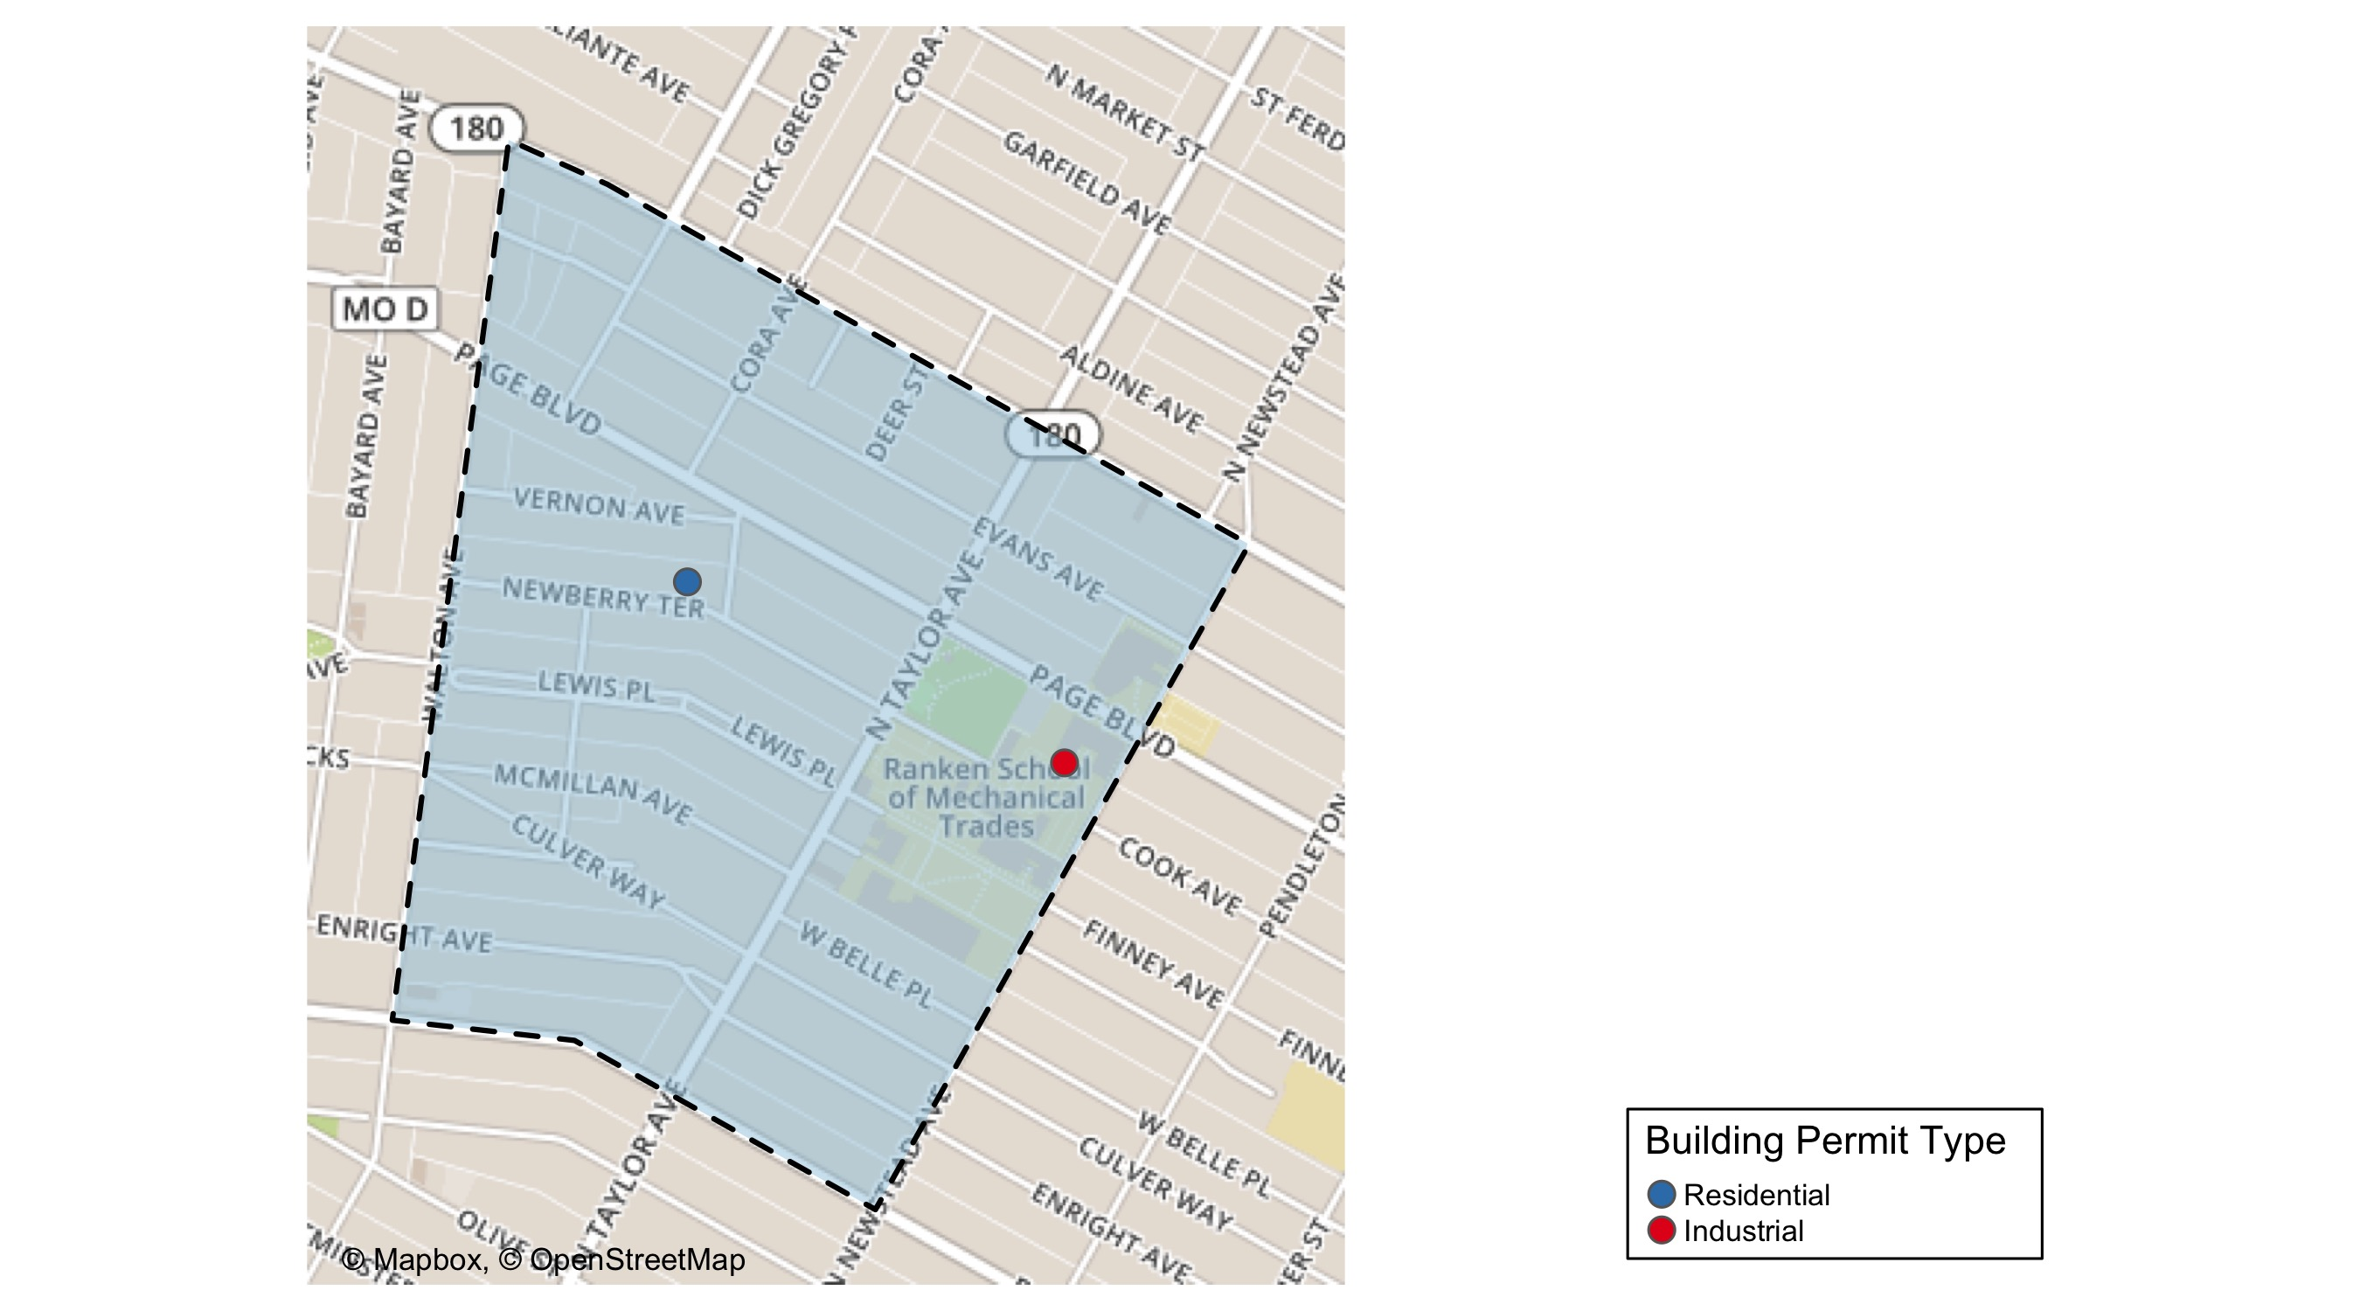
Lewis Place

Slide 48
Neighborhood Summary
July 2021 | July 2021 | July 2021 | July 2021
Permit Use | Average Cost | # of Permits | Total Value of Permits
Commercial | $0 | 0 | $0
Industrial | $56,000 | 1 | $56,000
Residential | $5,000 | 1 | $5,000
Last 6 Months | Last 6 Months | Last 6 Months | Last 6 Months
Permit Use | Average Cost | # of Permits | Total Value of Permits
Commercial | $10,000.00 | 2 | $20,000
Industrial | $18,733.33 | 3 | $56,200
Residential | $26,053.67 | 18 | $468,966

Slide 49
Lewis Place Individual Permit Breakdown
nbhd_name | Owner | New Use | Cost | address
Lewis Place | RANKEN TECHNICAL COLLEGE | Industrial | $56,000 | 4407 COOK AV
Lewis Place | DAVIS, DOROTHY J | Residential | $5,000 | 4617 NEWBERRY TER

Slide 50
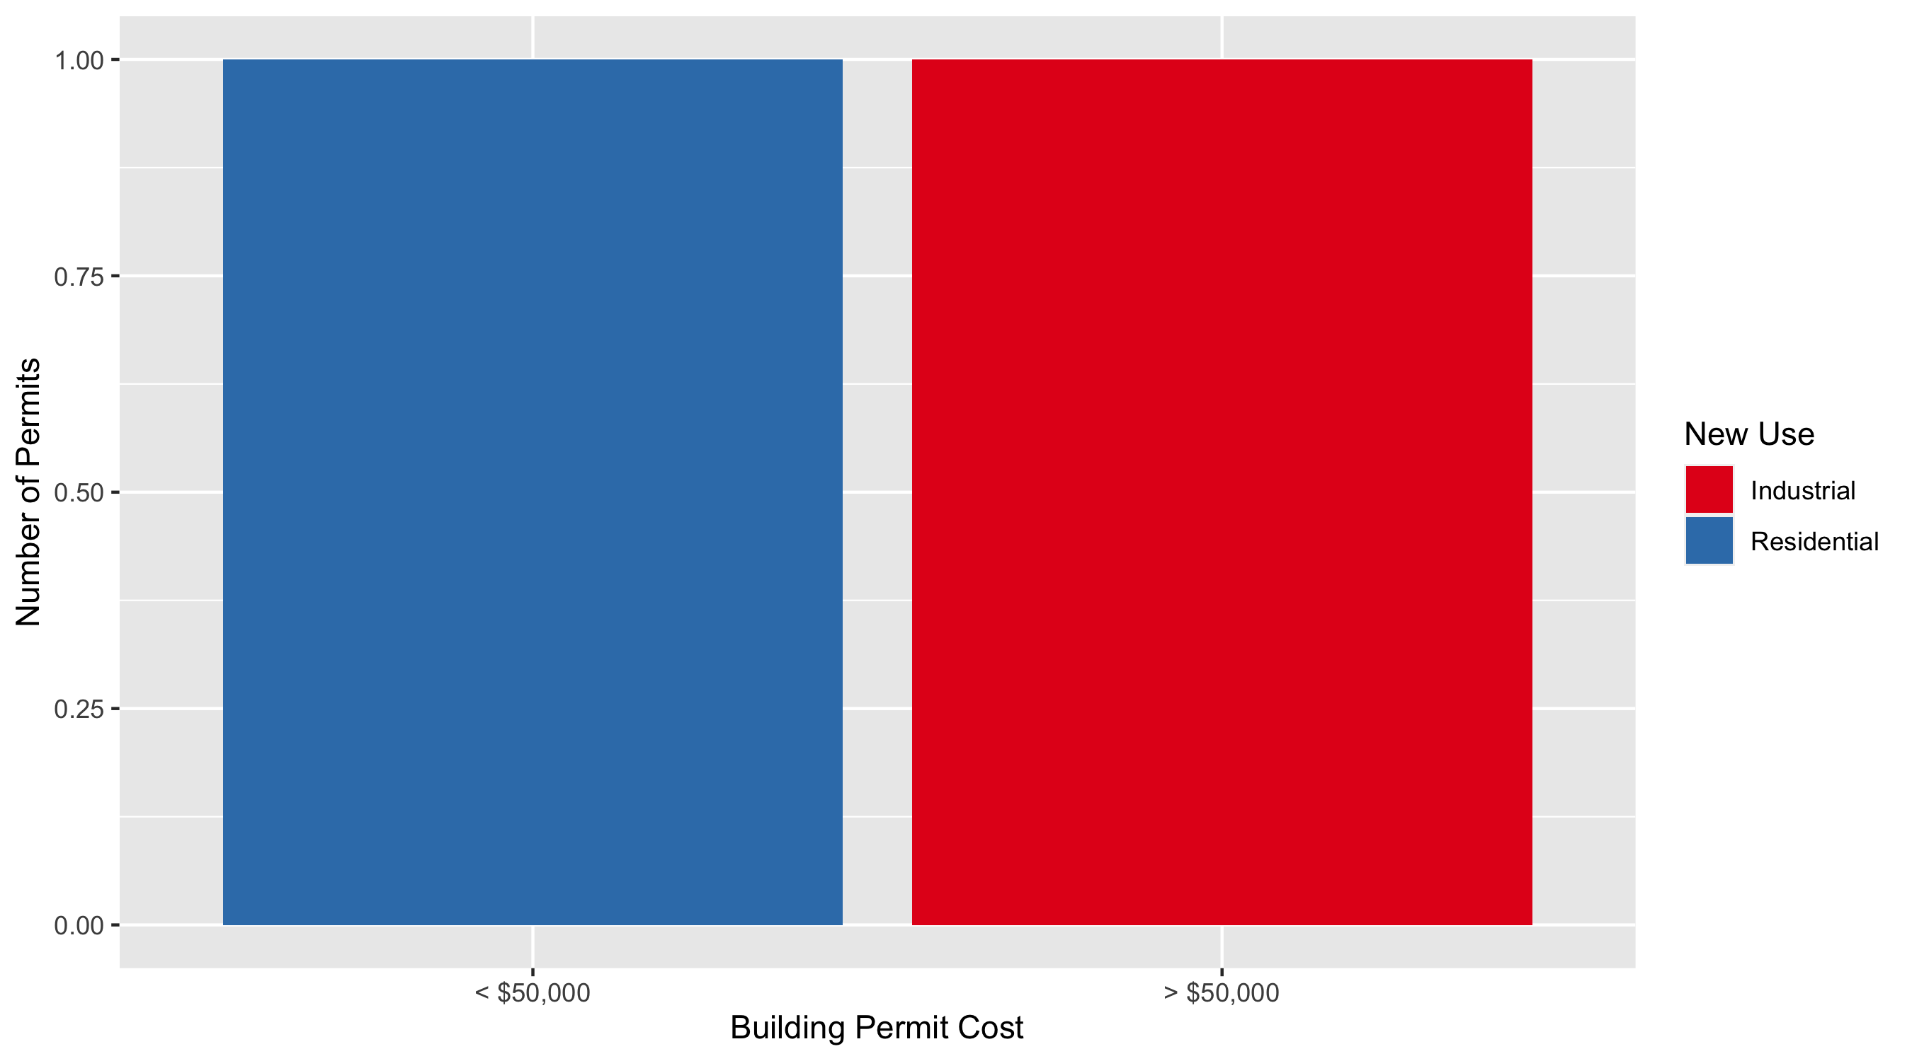
Lewis Place Permit Cost Breakdown

Slide 51
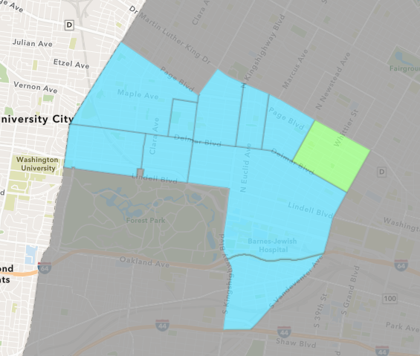
Vandeventer
July 2021 Neighborhood Cost Breakdown
Mean: $34,150
Median: $34,150
Range: $3,300 - $65,000

Slide 52
Vandeventer: Summary Notes
2 building permits in July 2021
Infinite change compared to July 2020 (0 total building permits)
$34,150: Average building permit cost in July 2021
Infinite change compared to July 2020 ($0)
4 total building permits in 2021
-42.86% change YTD compared to this time in 2020 (7 total building permits)
$22,325: YTD average building permit cost in 2021
-40.37% change YTD compared to this time in 2020 ($37,440)

Slide 53
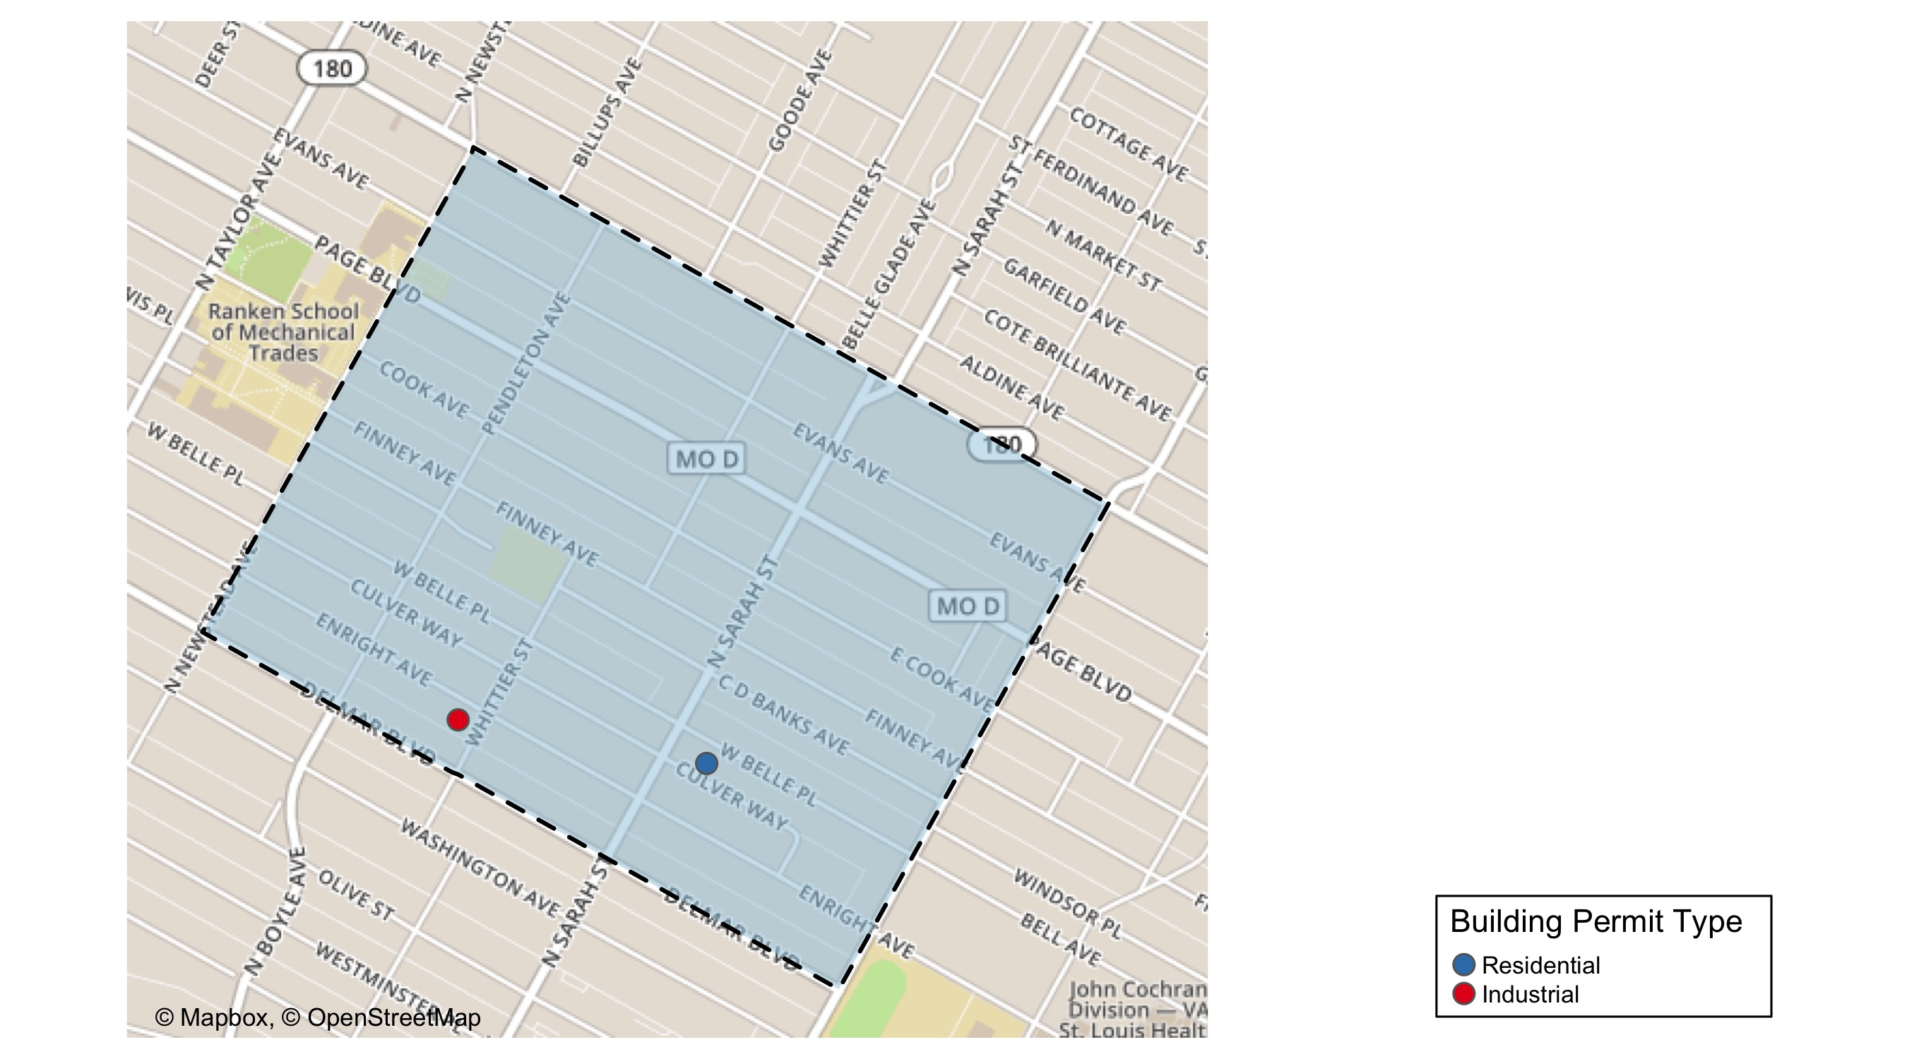
Vandeventer

Slide 54
Neighborhood Summary
July 2021 | July 2021 | July 2021 | July 2021
Permit Use | Average Cost | # of Permits | Total Value of Permits
Commercial | $0 | 0 | $0
Industrial | $3,300 | 1 | $3,300
Residential | $65,000 | 1 | $65,000
Last 6 Months | Last 6 Months | Last 6 Months | Last 6 Months
Permit Use | Average Cost | # of Permits | Total Value of Permits
Commercial | $28,223 | 3 | $84,669
Industrial | $3,300 | 1 | $3,300
Residential | $43,192 | 15 | $647,880

Slide 55
Vandeventer Individual Permit Breakdown
nbhd_name | Owner | New Use | Cost | address
Vandeventer | BOWLING, KEITH | Residential | $65,000 | 4048 WEST BELLE PL
Vandeventer | LOVE THE LOU | Industrial | $3,300 | 4210 ENRIGHT AV

Slide 56
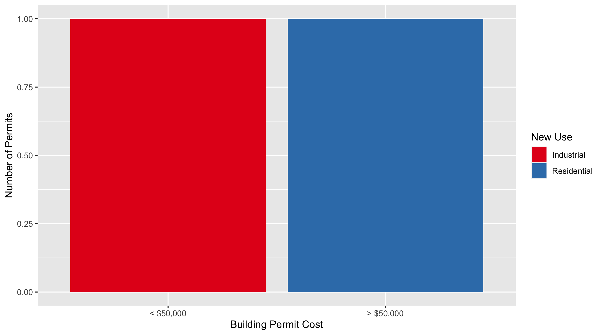
Vandeventer Permit Cost Breakdown

Slide 57
Additional Notes
Data retreived from https://www.stlouis-mo.gov/data/
Building permits with a cost of $0 were dropped
Building permits that were cancelled were dropped
Infinite change indicates 0 permits in the current or previous time period/comparison month so there was a overall increase or decrease

